Slide 1

Evaluation in the UN
Ana Rosa Soares & Tina Tordjman-Nebe

Slide 2
Introductions
Your name
Your institution
Your country

Slide 3
Overview of the course
Evaluation in the UN – Norms and Standards, Ethical Guidelines
2030 Agenda for Sustainable Development and Principles
Evaluation in Practice – step by step
Integrating LNOB, human rights, gender equality and disability inclusion in evaluations
Becoming an evaluator in the UN

Slide 4
Evaluations in the UN – Norms and Standards and Ethical Guidelines

Slide 5

United Nations Evaluation Group
Norms and standards for Evaluation
Norms
1 - Internationally agreed principles, goals and targets
2 – Utility
3 – Credibility
4 – independence
5 – Impartiality
6 – Ethics
7 – Transparency
8 - Human Rights & Gender Equality
9 – National Evaluation Capacities
10 - Professionalism
Standards
Institutional Framework
Management of the Evaluation Function
Evaluation Competencies
Conduct of Evaluations
Quality

Slide 6

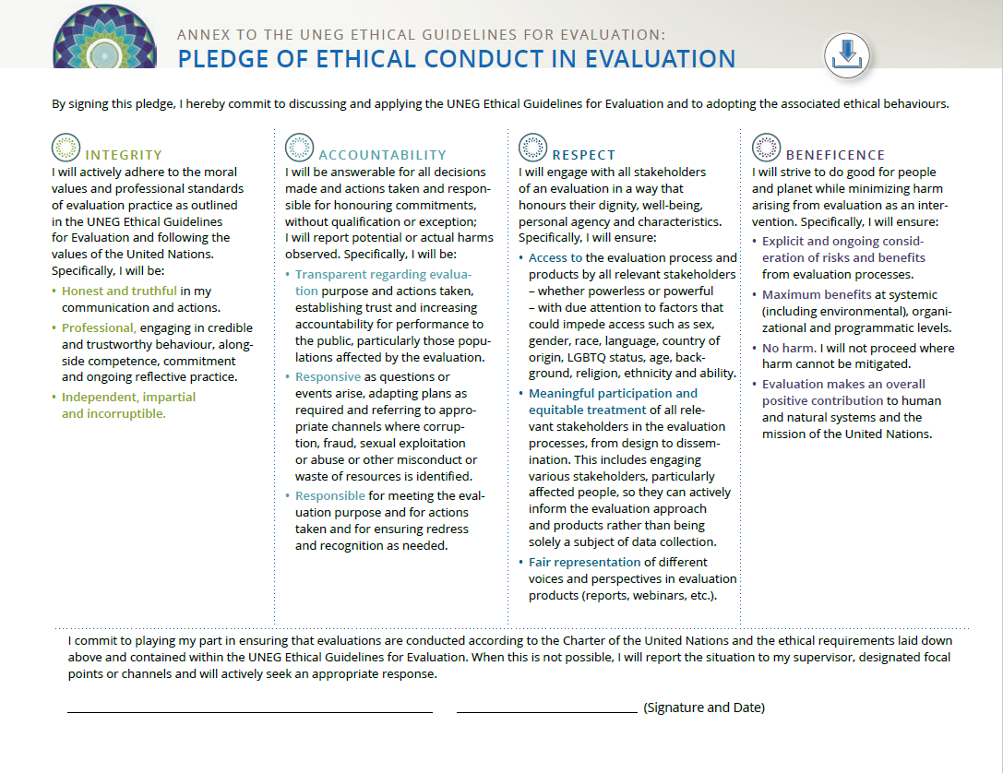
UNEG Ethical Guidelines for Evaluation

Slide 7
2030 Agenda for Sustainable Development and Principles

Slide 8

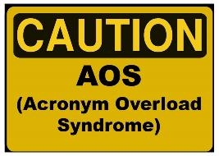






2030 AGENDA FOR Sustainable Development
SDG responsive - interrelated principles
Universality
Coherence
Integration
Leaving No One Behind (LNOB
- Reaching the furthest behind first (RFBF)
    Equality
    Non-discrimination
    Equity

Slide 9
Evaluation and “SDG principles”
Agenda 2030 and Sustainability
    Environmental, political, economic, socio-cultural
  PLANET -Protecting the planet
  PROSPERITY -Sustainable consumption and production
  PEOPLE -Sustainable, inclusive and sustained economic growth
  PEACE
  PARTNERSHIPS
Assessing “sustainability” thus needs to look at multiple dimensions

Slide 10

“Evaluating the SDGs”
For many “evaluation of the SDGs” = tracking progress against the indicators
Important, but insufficient
It is also crucial to evaluate the policies, strategies and programmes that are intimately tied to accomplishing the 17 SDGs

Slide 11
Evaluations in Practice
The experience of the UNDP Independent Evaluation Office

Slide 12
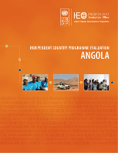
UN at country level
SDGs
National Development Strategy & expenditure frameworks
Strategic priorities for UN support
Theory of change
UN Sustainable Development Cooperation Framework
Cooperation Framework Outcomes
Outputs
UN Common Country Analysis (CCA)
Indicators
Project evaluations are commissioned by UNDP Country Offices (“decentralized evaluations”)
UNFPA Country Programme Document
UNICEF Country Programme Document
UNDP Country Programme Document (CPD)
Project
Outcomes
Outputs
Project
Indicators
Project
The IEO evaluates UNDP Programmes, not projects
Portfolios

Slide 13
Step 1: Design

Slide 14
Evaluability Assessment
What you can actually evaluate depends on CONTEXT, DATA, RESOURCES, TIMING/TIME
Are political, social and economic factors conducive?
  IF NOT, inform and involve stakeholders from beginning
  establish a reference group
Have a clearly defined results framework w/baselines and indicators?
  IF NOT, develop one retroactively with desk material and stakeholders
Do you have sufficient data or can use the necessary methods to answer questions?
  IF NOT, focus on plausible association, not causality but state limitations
Sufficient resources -including for the methods you would need to use?
  IF NOT, postpone or limit scope
In time for it to be useful and not biased?
  IF NOT, discuss postponing it or redefine scope

Slide 15
Evaluation purpose
CONTRIBUTION ANALYSIS
(how?)
Accountability
Transparency
Evaluation in UNDP
Learning
FACTOR ANALYSIS
(why)
Did they do it?
(What instead?)
Did they do it right? (How/why)
Relevance
Effectiveness
Efficiency
Sustainability
Effective
Efficient
Sustainable
Relevant
Impact
Did they do the right thing? (THEORY-BASED)
  CHECK EVALUABILITY TO IDENTIFY WHICH ONES POSSIBLE COVER

Slide 16
Designing the evaluation - expectations
TOR, concept note, inception report, evaluation plan/matrix
Exploratory/concept mission before developing the design
  Ideal, but rarely a possibility
  Design based on desk review and consultations
TOR with methodology (like our ICPE)
  Check evaluability
TOR requests a design (thematic)
  Check evaluability
May need to guide the commissioner
Explain the methodological limitations. Propose alternatives.
Still conduct an evaluability assessment

Slide 17
Evaluation design
  A general evaluation design should include:
Major evaluation issue or questions
  (Country/thematic/policy/what-why-how)
Evaluation approach
  (Results/programme/theory/summative/formative/developmental/realist/…)
Specific evaluation questions
  (Descriptive/normative/cause-effect…)
Methodology
  Data collection methods
  Data analysis methods
  (experimental/quasi/non-experimental/Quantitative/Qualitative/ Mixed/ Sampling)
Reporting /Dissemination
  (With/without recommendations)

Slide 18
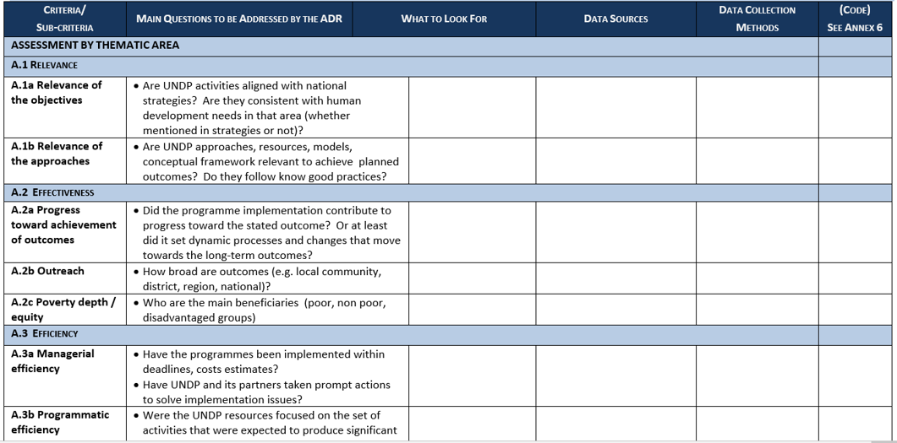
Example of evaluation matrix

Slide 19
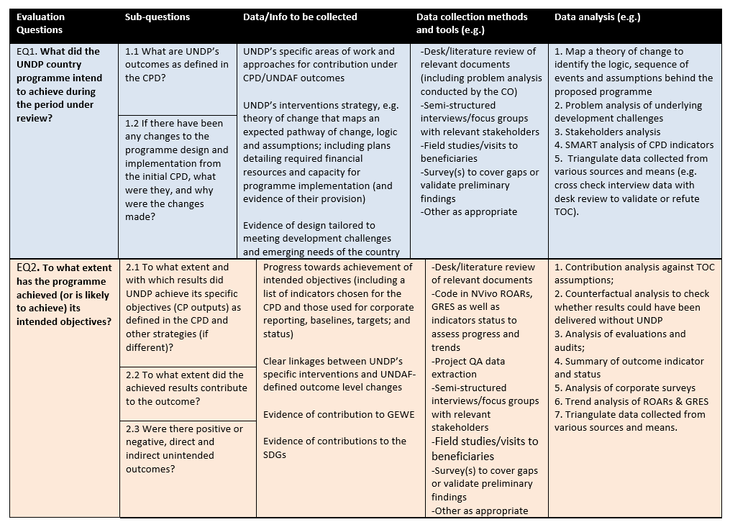
Example of design matrix

Slide 20
Example of a draft evaluation plan

Slide 21
Key criteria – general questions
Effectiveness – What has been UNDP’s contribution to outcomes (defined in CPD)?
Did they do it? Did they do the right thing?
Efficiency – Were resources used efficiently?
Did they do it? Did they do the right thing?
Value for money; Good management efficiency ratio
Comparative/competitive advantage used in a catalytic role
Sustainability – Were the results to which UNDP contributed sustainable or likely to be sustainable?
Capacities developed
Risks identified/addressed/mitigated
Exit strategy, national ownership
Relevance – Were the contribution relevant?
To the context, to national development priorities
To UNDP mandate and priorities, UN values and principles (SDGs/gender/HR/disability…)
Results delivered within time and budget;

Slide 22
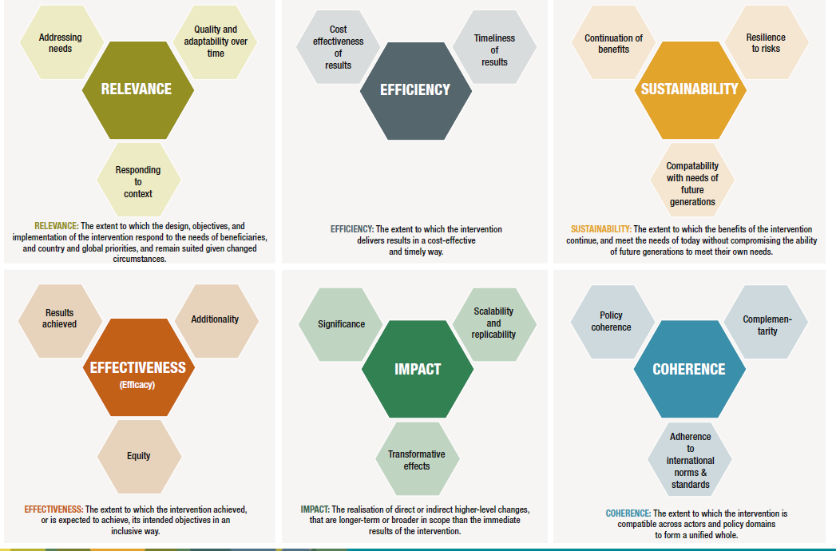
Other criteria being explored
Equity and gender,
human rights,
Partnerships,
synergies ,
Inclusiveness,
stakeholder engagement ,
Co-ordination,
Environment/climate change,
Design rigor,
Innovation,
Agility/adaptive management,
Scalability, replicability
Source: https:OECD – DAC Network on development evaluation 2019

Slide 23
PROGRAMME THEORY – BASED EVALUATION

Slide 24
Programme Theory Evaluation
Programme theory - set of hypotheses behind a chain of results leading to outcomes upon which a programme is built
Programme Theory Evaluation - theory that maps how to prove or disprove the programme contributed to the intended or observed outcomes.
The programme’s theory or the evaluator’s theory?
BOTH!
Stakeholders expectations and assumptions
Substantive Academic theories
Empirical analysis

Slide 25
Results in the UN System
Changes in conditions, behaviors, institutions and systems
CANNOT BE ACHIEVED ALONE IT IS CONTRIBUTION-BASED
Changes in skills, abilities, capacities of individuals or institutions
CAN BE “PRODUCED” BY ONE UN AGENCY/PARTER OR MORE
Outcome
Output

Slide 26
Results chains – Logical Framework
What do we want?
Why?
How?
Outcome
Short-medium term changes in conditions , behavior, institutions, systems and lives achieved as a result of all partners involved
Inputs
Financial, human and material resources
Outputs
Results achieved from direct support (skills, abilities, capacities )
Activities
Actions taken and services mobilized to generate outputs
Impact
Long term development effects that benefit people
Resources
Results

Slide 27
From Logframes to programme Theories of Change

Slide 28
EXERCISE
Let’s split into groups of 5
Groups will receive a puzzle to complete
AND you will have to collaborate between teams to complete the exercise.

Slide 29


Logframes versus TOC
Fitting squares into holes
Puzzle
Opportunity focused
Demand driven
Project based
Philanthropy
Did they do it?
Theory focused
Supply driven
Programme based
Integration
Partnerships
Synergy
Did they do the right thing?
Did they do it right?

Slide 30
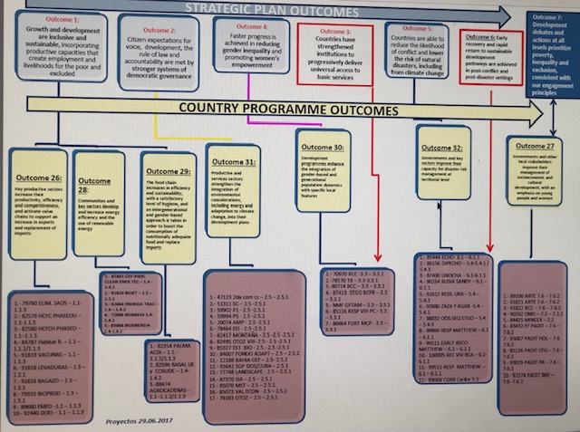
Aligning squares into holes

Slide 31
Puzzle - malaria burden reduced map
Language
skills
Visits to pregnant ladies
Supply chain
Prevention
Treatment
Vector control
Prophylaxis
Tests
Stock management
Roads
Mosquito nets
Training knowledge transfer
Campaigns
Trucks
Warehouse
system
M&E
Behavior change
Strategic patience
Doctors+
Meds

Slide 32
Abridged TOC with stakeholders
Malaria burden reduced
Supply chain
Procurement - UNDP
Risks
Assumptions
Tests
UNDP
nets
UNDP
Meds
UNDP
Profilaxis meds
Visits to pregnant women - UNICEF
distribution
Trucks
GOV
Roads
Bank

Slide 33
How do evaluators use TOC?
TOC - Sense-making evidence mapping framework
Use to map of what evidence to look for considering:
  Assumptions IF-THEN-DEPENDING
    Context, Negative and positive feedback loops,
    Instruments (sticks and carrots) (how);
    Mechanisms (social norms, incentives, patterns, determinants, triggers of change…(why)
    SDG integration, synergy
The evidence you find should indicate if the theory worked or not, how and why.
BUT, be mindful of implementation failure X theory failure

Slide 34
IF-THEN-DEPENDING
beneficiaries more capable to changed
financial constraints
Opportunity costs
THEN 3
IF beneficiaries:
Are motivated
Receive incentives
THEN 1
Beneficiaries participate in the programme
Attend courses
Receive technical assistance
THEN 2
beneficiaries will better understand their production system and the problems they face
THEN 4
beneficiaries will apply the imparted knowledge on their own business
Newly earned Practices
Cultural practices
THEN 8
Beneficiaries will adapt their business system from conventional to newly learned methods
THEN 9
The full benefits associated with the different practices and integrated application of practices will appear
Less failure
Improved results
More income
Selection mechanisms
Distance and travelling costs
THEN 5
THEN 6
Beneficiaries will share the knowledge with their neighbors
Characteristics social structure
Beneficiaries will organize themselves to exchange ideas and experiences
THEN 7
Companies will be able to work with beneficiaries groups

Slide 35
Map evidence to look for/report findings

Slide 36
Map way forward - recommendation
Guinea Bissau
Poverty Reduction
Economic growth
Climate change adaptation (incl. DRR)
Governance
Employment creation –Community based initiatives
Resilience
GEWE
Human Rights
Finance LED plans
Full value-chains
Oversight by civil society and media
Integrator of actors to call to action
Transitional justice
Work with traditional leaders on human rights
Health
If enabling environment (political stability), then…
Upstream policies and laws
Functioning professional public service
If reforms and stability are in place, then…
Central government trainings and study tours

Slide 37
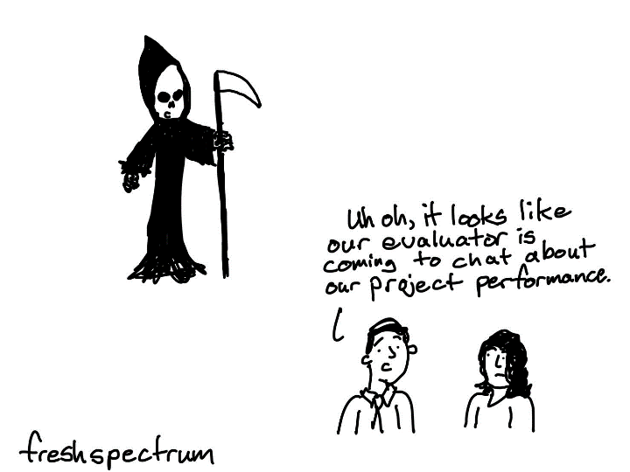
Step 2: Data Collection

Slide 38
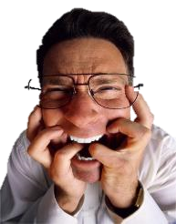
Evalophobia
Fear of evaluation, often manifested in unreasonably strong dislike of, or opposition to, evaluation.
Evaluators will not understand us
Evaluation is too expensive, takes too long
We have enough monitoring and reviews
We have extensive knowledge and experience
Information will be abused, hurt us
Programme will be terminated
It will inhibit innovation
It will not be used
Don’t give me bad news

Slide 39
Data collection
Start with a desk review report
identify evidence gaps to focus on data collection missions
Conduct virtual interviews with staff for (understanding/context/TOC)
Send a pre-mission-questionnaire or survey
shorten the time of interviews with staff
Develop a data collection plan for the mission

Slide 40
Stakeholder mapping /analysis
Map who to consult for data/perceptions/evidence collection with what methods
Map how different stakeholders contribute to a result – assess whether all pieces of the puzzle are in place to achieve result.
Map how UNDP engages with/contributes to stakeholders – for value added
Map integration and synergies

Slide 41
Agenda
Ensure you have for each meeting:
participants names;
position titles;
complete address and references;
telephone numbers for emergency contact;
project/area of work with UNDP;
designated driver
Any special protocol we should follow.
Leave 30 minutes from one meeting to another
Meetings with only one person can be of 45’;
with more than one person it requires 60 to 90‘.
Focus groups require at least 90'.

Slide 42
Map how different stakeholders contribute to a result
Supply chain
Procurement chain - UNDP
Nets
UNDP
Meds
UNDP
Tests
UNDP
Prophylaxis pregnant women/children UNICEF
distribution
Trucks
GOV
Roads
BANK

Slide 43
Map how your agency engages /contributes - for value added
Trucks
Warehouse
Campaign
M&E
Nets
Distribution
Meds
Ministry of health
UNDP
Tests
Visits to pregnant women
M&E of women/children
UNICEF
World Bank Group
Roads
Treatment

Slide 44
Map integration/synergy/silos
Antonio
Denise
Erika
Aline
Jin
Carlos
Heather
Caroline
Ana
Richard
Genta
Seo-jun
Rogerio
Fumika
Alan
Rachid
Karl
Li Na
John
Glayson
John
Ieva
Flavio
Mamadou

Slide 45
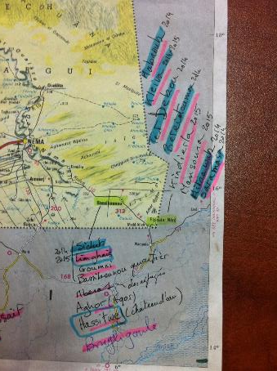
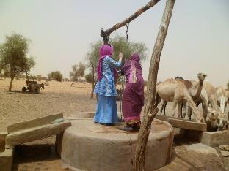
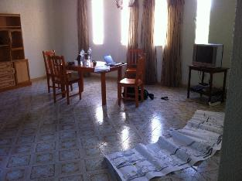
Field data collection
Use ethical guidance – Ask permission to use recording devise and even to approach and ask questions
highlight anonymity – not confidentiality – you ARE on record
Explain the evaluation, responsibilities and final results’ purpose
Do not repeat information from another interview
Be careful with leading questions, face expressions, nodding
Perception is not enough, ask for evidence/examples
- what evidence is there of what you perceived?
Interview Protocol - set minimum questions and coding
Can’t get critical comments?
  Ask for recommendations to better position/improve the agency/
  programme

Slide 46
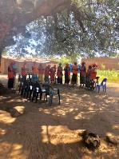
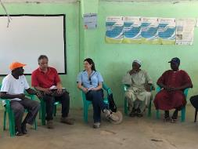

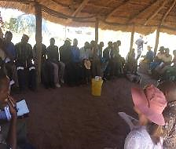
Out there in the field …
Vaccines/prophylaxis, repellent, phone, radio, water pills, boots/hills
Security training/clearance
Protocolary meetings – do no harm
Respect culture, ask about it (words, attire, seating, touching)
Assess familiarity and adapt
Do not create expectations.
Observation (be ready to take pictures, but ask first)
Independence - Programme staff step out during interviews
Get contacts for additional document collection
Ensure enough time between meetings, do NOT be late

Slide 47
Data collection debriefing
Organize data around:
Points for clarification
Areas for recommendation
Negative/positive factors
TOC validations and failures
Value added/comparative advantages
Contributions to outcomes and beyond (criteria)
Strategic positioning/Opportunities
SDGs (gender, HR, HD)
Context (internal/external – including management/culture)
Consider the following key elements:
Preliminary findings

Slide 48


Step 3: Analysis
Align to organize
Aggregate to analyze

Slide 49

Align to organize
Thematic area (if more than one outcome associated)
    Outcomes
      Projects/interventions/initiatives
        stakeholder/partnership.
Issue/problem - map integration/systems
Solution/outcome (if outcomes are not integrated)
Stakeholders/partnership - many projects with few partner(s)

Slide 50

Aggregate to analyze
Track patterns and variations
Map results in TOC
The greater the variation the more complex the theory - not necessarily indication of failure.

Slide 51
Map analysis results against TOC
Confirmed
Not confirmed
Mixed results

Slide 52
Testing quality of evidence - Validity
How do we know that an intervention, rather than other has caused a change?
How do we know we can generalize the results found?

Slide 53
Testing quality of evidence – Validity
Attribution – causality (counter-factual) – inferential statistics/econometrics
(project)
Test for internal validity of causal relationships – need control/comparison
Test for external validity to be able to generalize – need representative sample
Contribution – plausible association (before and after)- quanti/quali
(Programme)
Test convergence of theory/literature X findings
Test data analysis validity – need triangulation of methods and sources
statistical validity – consider variability, scale, magnitude
Test rival theories – consider variability and context

Slide 54

Checking triangulation of evidence
Compare data between different methods and sources
Understand reasons for conflicting results, try other methods / sources
Method / Source A
Method / Source B
Method / Source C
Results diverge
Results converge
The greater variation the more complex the theory, not necessarily indication of failure

Slide 55
Contribution analysis steps
Contribution analysis does not expect to firmly establish causality but rather seeks to achieve a plausible association.
1. Set out cause-effect/challenge to be addressed
2. Develop TOC with assumptions and risks to links in chain & rival explanations
3. Gather the existing evidence on the TOC
4. Assemble and assess the contribution claim and challenges to it
5. Determine additional evidence needed to enhance credibility of claim
6. Revise and strengthen the contribution story
7. Use the contribution to produce recommendations for improvements

Slide 56
Step 4: Reporting

Slide 57

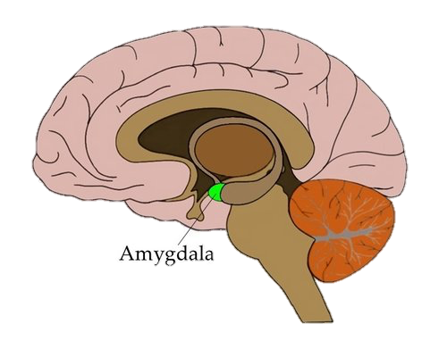
Passing palatable messages

Slide 58
Passing palatable messages
Be aware of the fear factor that affects collaboration and use of evaluation
Avoid words such as: failed/failure, unless you want a particular attention (amygdala frenzy)
Present weaknesses as opportunities
Accountability x learning
Constructive but not sanitized that it loses credibility
Be objective but explain complexity works with subjectivity
Engage, empathize but keep impartiality
Provide nuanced analysis of why findings are so negative
Present what would have been possible otherwise/if

Slide 59
Report writing
Context
Programme – scope
Methodology
Findings
Conclusions
Recommendations
Management responses
Annexes
Language

Slide 60
Findings
What they succeeded achieving (results/not efforts)
How (through and what role they took)
Factors contributing to success
Whether what they achieved was not the right/best thing or insufficient as a solution to the problem (per TOC )
What is missing/lacking
What they failed/is pending to achieve
Why
Factors hindering success

Slide 61
Conclusions
Be substantiated by findings consistent with data collected and methodology, and represent insights into identification and/or solutions of important problems or issues.
Add value to the findings
Show logic and correlation to findings
Focus evaluation objectives and key questions
Avoid the well known and obvious
Attribution require detailing

Slide 62
Recommendations
Firmly based on evidence and analysis, be relevant and realistic, with priorities for action made clear
Relevant to subject, TOR and objectives of the evaluation
Clear and concise
Prioritized
State responsibilities and the time frame
Linked to findings and conclusions
Source: file:///C:/Users/ana.soares/Downloads/Checklist%20on%20Quality%20fo%20Evaluation%20recommendations..pdf

Slide 63
Rights-Based and Inclusive Approaches to Evaluation

Slide 64
Exercise
Imagine now you are switching sexes, or gender identity – if you prefer (and know the difference) AND you are visually impaired
You will now be tele transported to a desert island with a group from the other sex who are not living with a disability
  Reflect on, what would you fear most now that you are the other sex and visually impaired?
  Write down, what would you like most now that you are the other sex and visually impaired?

Slide 65
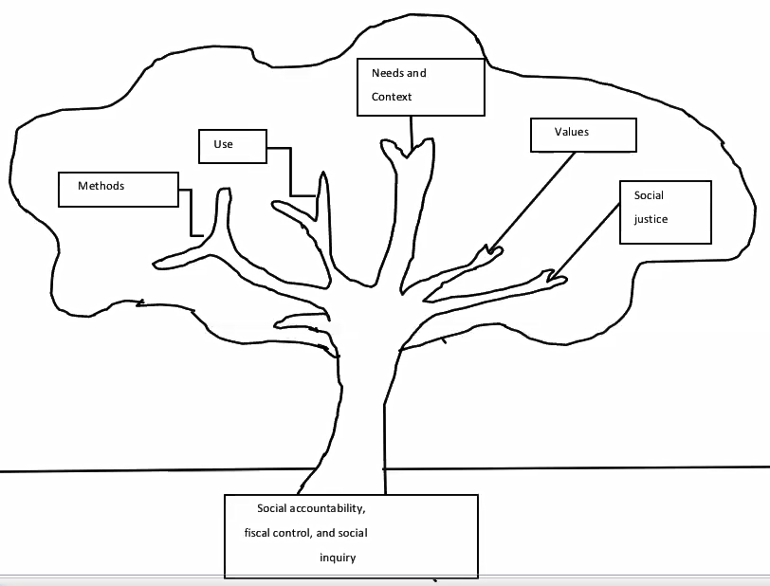
A five-branch tree of evaluation approaches
Focus on social justice and people-centred approaches

Slide 66
Intersectionality
Intersectionality calls for recognizing the experience of overlapping, simultaneous systems of oppression
Taking an intersectional approach requires a focus on the multiple identities of those left behind, and on context (historical, social, etc.)
Kimberlé Crenshaw’s original example: racism + sexism = one whole, simultaneous effect on experience
Crenshaw, Kimberle, ‘Demarginalizing the Intersection of Race and Sex: A Black Feminist Critique of Antidiscrimination Doctrine, Feminist Theory and Antiracist Policies’, University of Chicago Legal Forum 1989, pg. 139-167.
    It makes more sense to concurrently consider all factors that potentially leave people behind, and assess how they interplay to create disadvantage

Slide 67
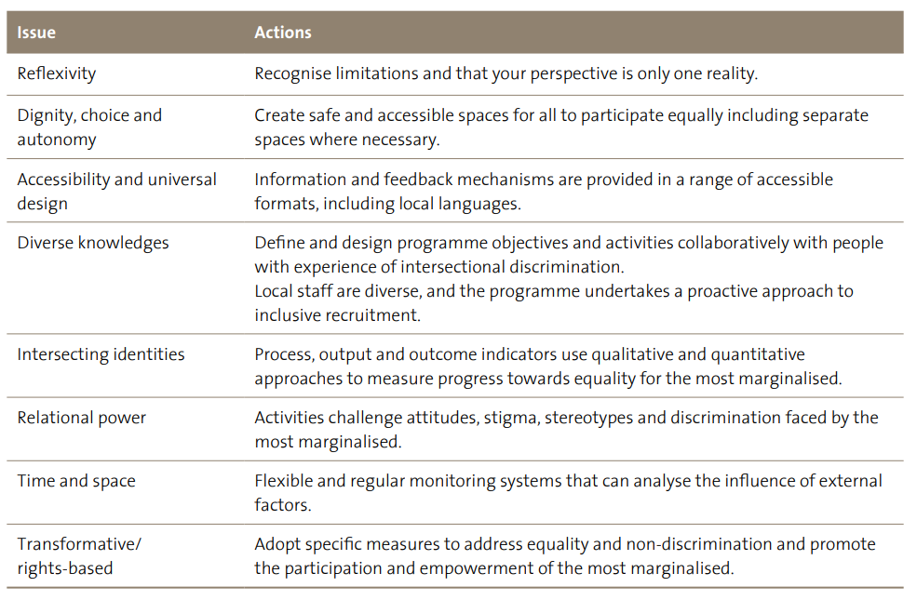
Intersectionality Levers
Help assess the extent to which an intersectional approach was employed in programme design and implementation
Intersectionality enablers as per UN Women, ‘Intersectionality Resource Guide and Toolkit: An Intersectional Approach to Leave No One Behind’, UN Women 2021, page 17.

Slide 68
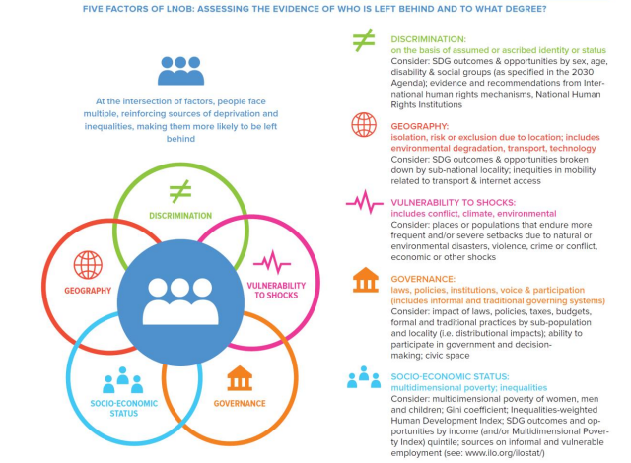
Five factor framework
Helps assess how factors intersect to produce disadvantage and deprivation.
Source:
UNSDG, ‘LNOB: A UNSDG Operational Guide for UNCTs’, UNSDG 2019/2022, pg.13; based on UNDP, ’What Does It Mean To Leave No One Behind? A UNDP discussion paper and framework for implementation’, UNDP 2018, pg. 3.

Slide 69
LNOB Language Use – Key Definitions
Equality: the imperative of moving towards substantive equality of opportunity and outcomes for all groups
Equity: the broader concept of fairness in the distribution of costs, benefits and opportunities
Inequality: the state of not being equal, especially in status, rights, and opportunities
Non-discrimination: the prohibition of discrimination against individuals and groups on the grounds identified in international human rights treaties
Please be careful using the following terms:
Disadvantaged
Empowerment
Marginalization
Minority
Vulnerable population
When appropriate make an effort to replace disadvantaged, marginalized or vulnerable population with the term groups that are most likely to be left behind

Slide 70
Framework for analysis: Analyze – Empower - Enact
Helps assess to what extent three mutually enforcing LNOB levers were employed in programming
Examine (disaggregated and people driven data and information): Monitoring SDG progress of all relevant groups and people by collecting, analyzing and making available disaggregated and people-driven data and information on who is left behind and why. Track the progress of those furthest left behind relative to everyone else.
Empower (civic engagement and voice): Enable people that are being left behind to be equal agents in sustainable development, ensuring their full and meaningful participation in decision-making by providing safe and inclusive mechanisms for civic engagement.
Enact (integrated, equity-focused SDG policies, interventions and budgets): Develop integrated equity-focused SDG policies, interventions and budgets to support rights-holders and duty-bearers to address the intersecting disadvantages and deprivations that leave people behind.
’What Does It Mean To Leave No One Behind? A framework for implementation’, UNDP undated.

Slide 71
Example of an organizational “LNOB profile” from recent UNDP evaluation
 | Examine | Empower | Enact
Poverty & Inequality
Governance
Resilience
Environment
Energy
Gender Equality
Profile of UNDP Signature Solutions with regard to LNOB & RFBF
Source: LNOB evaluation team. Legend: dark green – significant contribution; light green – good contribution; yellow – moderate contribution; orange – limited contribution; red – no or ineffective contribution.

Slide 72
Group Work on Five-Factor Framework/
Intersectionality
Group 1: UNDP supported community-based partner organizations in collectivizing and organizing women waste pickers and facilitating their participation in urban solid waste management. The beneficiaries reported an increase in income.
Group 2: Through UNDP-supported rule-of-law interventions, access to justice for women increased in 3 rural districts. The intervention was not accompanied by upstream efforts to amend discriminatory legislation.
Group 3: The UNDP-UNV Talent Programme for Young Professionals with Disabilities provided employment opportunities with UNV, working with 33 Young Professionals with Disabilities.

Slide 73
LNOB lessons learned so far
why just gender & disability but not other forms of exclusion / What about other populations likely to be left behind? For example youth, IDP – keep them all in mind
Be careful about lumping groups, such as girls and women, gender and youth, gender and LNOB - we get negative marks on SWAP when we do it
LNOB is not a requirement in the tools of many organizations YET, such as CPD, guidance…
  Look for when assessing if they are covering who is deprived, in what dimension, and whether they have a programmatic portfolio approach

Slide 74


Guidelines
Source: http://unevaluation.org/document/detail/1616

Slide 75
HR & GE responsive evaluations
Integrate in their purposes, processes and methods, HR & GE concepts, standards, values and principles
Analyze how an intervention advances the rights of targeted populations (rights holders), particularly women and individuals/groups who are marginalize and/or discriminated against…
Identify and analyze the inequalities, discriminatory practices and unjust power relations that are central to development problems…
Ensure that rights’ holders voices are heard…

Slide 76

UNDP evaluation guidelines
What do the UNDP Evaluation Guidelines say about integrating gender equality into evaluations?

Slide 77
Integrating gender into TORs
  Gender equality and women’s empowerment and other cross-cutting issues need to be included in the scope of the evaluation
  At least one evaluation question should address the issue of gender*
  Methodologies for addressing gender-specific issues should be requested
  Evaluation team composition and required competencies should encompass gender
“A gender responsive evaluation should be carried out even if the subject of evaluation was not gender-sensitive in its design”

Slide 78
Gender responsive evaluation questions
Relevance
  To what extent is the initiative in line with the UNDP mandate, national priorities and the requirements of targeted women and men?
Effectiveness
  To what extent have the results at the outcome and output levels generated results for gender equality and the empowerment of women and girls?
Efficiency
  To what extent did UNDP promote gender equality, the empowerment of women and girls, human rights and human development in the delivery of country programme outputs?
  Sustainability
  To what extent do mechanisms, procedures and policies exist to carry forward the results attained on gender equality, empowerment of women and girls, human rights and human development?

Slide 79

Evaluation teams
At least one evaluation team member should have technical knowledge and experience in gender equality and rights-based approaches
Evaluation teams should be, to the extent possible, gender balanced

Slide 80
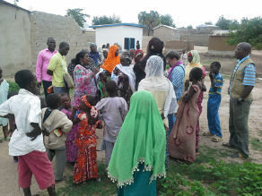

Data collection
Ensure methods and tools for data collection will
  Integrate gender considerations
  Disaggregate data by sex and other relevant categories, and
  Employ a diverse range of data sources and processes to ensure inclusion of diverse stakeholders, and that the voices of women and others likely to be marginalized are heard and taken into account
  Be sensitive to cultural and security considerations

Slide 81
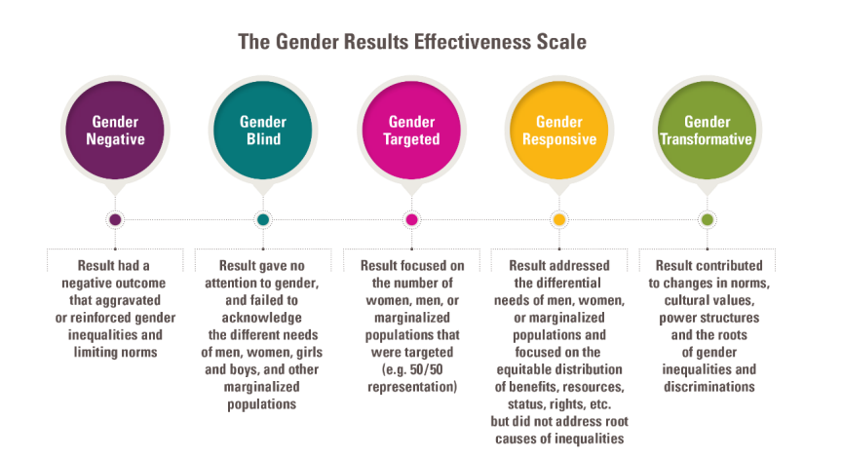
Analysis: Using the GRES

Slide 82
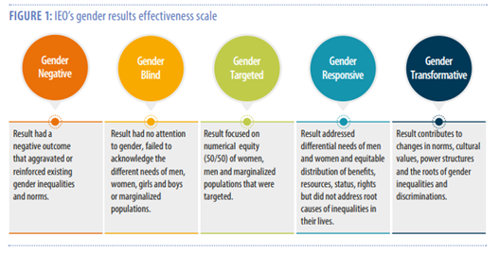
Using the GRES to formulate a finding
FINDING: This outcome is composed of initiatives (programmes/projects/activities/oroductrs/soft assistance/advocacy) that are (mostly OR a mix) of (negative/blind/targeted/responsive/transformative results.
(avoid the GRES jargon use the description).
UNDP gender marker mostly reported was (0,1,2,3 explain).
Triangulation of evidence found the attention to gender in terms of resources equivalent to gender marker 2, meaning gender was not the main objective of the expected outputs, but the output did promote gender equality in a significant and consistent way. (explain the 0,1,2,3)
Key achievements have been… factors contributing/hindering were…

Slide 83
Using the GRES to formulate a conclusion
Gender Targeted
CONCLUSION: Adding gender is not equivalent to integrating it.
UNDP ensured the participation/integration of women and marginalized groups in all its programme, projects and activities.
While some of its work seeks to achieve ‘transformative’ changes, the approach used was ‘gender targeted’, focused on the ratio of men to women, rather than on addressing men’s and women’s differential needs throughout its interventions, or by seeking to bring about changes in the norms or the structures of power that contribute to discrimination and inequalities.

Slide 84
Using the GRES to formulate a conclusion
Gender Responsive
CONCLUSION: Addressing differential needs, benefits, resources, status, rights BUT NOT YET solving root causes.
UNDP has developed an ‘integrated’ holistic gender strategy and is implementing a programme /portfolio approach that is working less in silo connecting multiple stakeholders and partners to address the differential needs of men and women, considering more equitable distribution of benefits, resources, status and rights of different genders and groups.
The programme is not yet effectively addressing root causes of inequalities, especially in the lives of the most likely to be left behind (the vulnerable/marginalized) for the following reasons….

Slide 85
Using the GRES to formulate a conclusion
Gender Transformative
Conclusion: Behavior change conducive due to norms, cultural values, power structures and root causes of gender inequalities and discriminations being modified, accepted and sustained over time.
UNDP has contributed to the modification, enforcement and sustaining of change in norms, cultural values and power structures in the country in partnership with the Government and several other stakeholders BY fully implementing a holistic theory of change and action that addressed the root causes of gender inequalities and discriminations over time.
Factors that contributed to this sustainable success include (changes to values, benefits, resources, status and rights) …

Slide 86
Using the GRES to formulate a recommendation
From Gender Targeted to responsive
RECOMMENDATION: Moving UNDP contributions from gender targeted to gender responsive.
UNDP should move away from simply ensuring the participation and ratios of men and women engaging in initiatives and focus on addressing the differential needs, benefits, resources, status, rights of different genders and those most likely to be left behind.
UNDP should develop an ‘integrated’ holistic gender strategy and have a programme /portfolio approach to work less in silo and engage with multiple stakeholders and partners to address the differential needs of men and women, considering more equitable distribution of benefits, resources, status and rights of different genders and the ones most likely to be left behind ‘vulnerable/marginalized groups’.
This can be achieved by seeking to bring about changes in the norms and structures of power.

Slide 87
Using the GRES to formulate a Recommendation
Gender Responsive to gender transformative
RECOMMENDATION: Moving UNDP contributions from gender responsive to gender transformative.
UNDP is now well positioned to develop an ‘integrated’ holistic gender strategy to advance towards addressing behavior change to be achieve by norms, cultural values, power structures and roots of gender inequalities and discriminations being modified, accepted and sustained over time.
UNDP should partner with key stakeholders to support the Government and civil society in the adaptation, enforcement and sustaining of change in norms, cultural values and power structures in the country by fully implementing a holistic theory of change and action that addresses the root causes of gender inequalities and discriminations over time.
This will ensure sustainably addressing the differential needs of men and women, with more equitable distribution of benefits, resources, status and rights of different genders and the ones most likely to be left behind ‘vulnerable/marginalized groups’.

Slide 88
Exercise: Using the GRES
Divide in 5 groups
Assess the 5 given results
  Where you think these results fall on the “GRES” Spectrum?
  What additional information you would have liked to have had?
  Are there any challenges in applying the GRES?

Slide 89
The UN Disability
Inclusion
Strategy
June 2019
Disability inclusion refers to the meaningful participation of persons with disabilities in all their diversity, the promotion and mainstreaming of their rights into the work of the Organization, the development of disability-specific programmes and the consideration of disability-related perspectives, in compliance with the Convention on the Rights of Persons with Disabilities (CRPD).
This requires the development and implementation of a consistent and systematic approach to disability inclusion in all areas of operations and programming, internally and externally. (UNDIS)

Slide 90
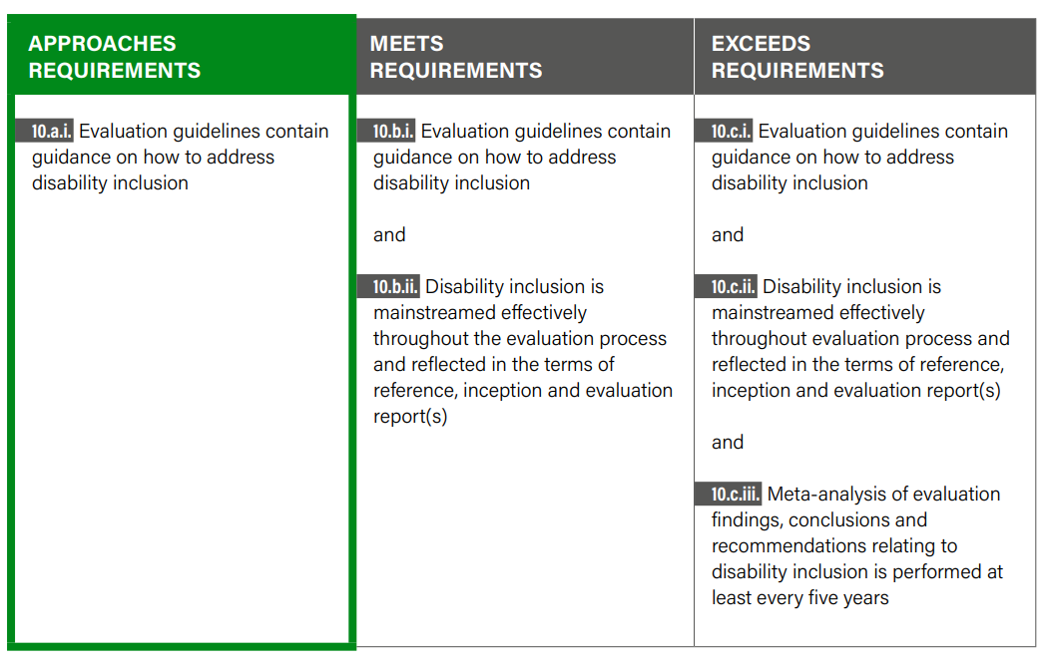
UNDIS Evaluation Indicators
Disability inclusion should be considered in evaluations, including those that do not have a specific focus on disability inclusion.
IEO has been reporting on the UNDIS Evaluation Indicator since 2020. The 2021 report will be submitted in early March.

Slide 91
DIS Technical Note and UNEG Guidance
(Jan 2022)
•The ToRs of evaluations pay adequate attention to disability inclusion.
•Evaluation teams have knowledge and/or experience of disability inclusion, where relevant.
•Evaluation questions cover different aspects of disability inclusion.
•Evaluation stakeholder mapping and data collection methods involve persons with disabilities and their representative organizations.
•Evaluation findings and analysis provide data and evidence on disability inclusion.
•The conclusions and/or recommendations of evaluations reflect their findings on disability inclusion.

Slide 92
COVID-19, Inequalities, and Building Back Better/Forward
Ensure social cohesion and community resilience
Build stronger, equity-focused health systems
Strengthen social protection and public services
Implement gender-responsive economic policies, based on international solidarity and multilateral collaboration
Forge a job-intensive recovery for people-centered and environmentally sustainable economies
Digitalization
(digital solutions)
Green recovery

Slide 93
Step 5: Quality Assurance

Slide 94
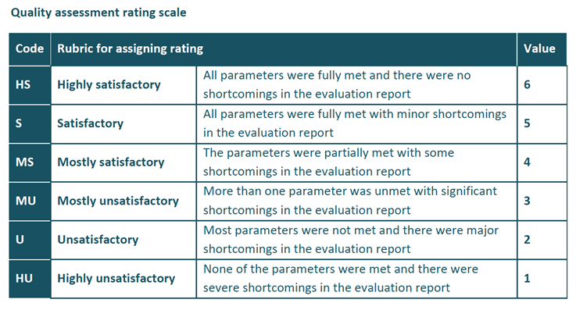
UNDP’s quality assessment system
Quality assessing your own reporthttp://web.undp.org/evaluation/guideline/documents/PDF/section-6.pdf

Slide 95

Gender quality assuring the draft report
Description of the intervention: Are relevant cross-cutting issues such as gender equality, human rights, marginalized groups or “leaving no one behind” identified?
Evaluation approach and methods: Does the report specify how gender equality, vulnerability and social inclusion were addressed in the methodology, including how data-collection and analysis methods integrated gender considerations?
Findings: Findings should reflect a gender analysis and cross-cutting issue questions
Conclusions: Should respond to key evaluation questions… including issues in relation to gender equality and women’s empowerment
Recommendations: Should address any gender equality and women’s empowerment issues and priorities for action to improve these aspects

Slide 96
UN-SWAP EPI
All UN entities are required to assess the extent to which evaluation reports meet the gender-related UNEG Norms and Standards for Evaluation
3 criteria
  Gender equality and the empowerment of women are integrated in the evaluation’s scope of analysis, and evaluation criteria and questions are designed in a way that ensures that relevant data will be collected
  Gender-responsive methodology, methods, tools and data analysis techniques are selected
  The evaluation findings, conclusions and recommendations reflect a gender analysis

Slide 97
UN-SWAP EPI
4 point scoring scale
  0 = Not at all integrated. Applies when none of the elements under a criterion are met.
  1 = Partially integrated. Applies when some minimal elements are met but further progress is needed and remedial action to meet the standard is required.
  2 = Satisfactorily integrated. Applies when a satisfactory level has been reached and many of the elements are met but still improvement could be done.
  3 = Fully integrated. Applies when all of the elements under a criterion are met, used and fully integrated in the evaluation and no remedial action is required.

Slide 98
Report scores
Individual Report Scores
0-3 | Misses requirements
4-6 | Approaches requirements
7-9 | Meets requirements
The aggregated score is reported as part of the agency scorecard in the UN-SWAP online reporting system
Each assessed report receives a score.
The scores are then aggregated to provide the agency score, reported annually.
Aggregate Scores
0-3,49 | Misses requirements
3,50 – 6,49 | Approaches requirements
6,50 – 9,0 | Meets requirements

Slide 99
Becoming a UN Evaluator

Slide 100
How does UNDP recruit evaluators?
Consultants for specific evaluations
  Follows UNDP procurement rules
  Applications with cover letter, CV/P11, financial offer, possibly writing samples
    Screened against TOR
  Interviews
  Reference checks

Slide 101
Competency-based interviews
Questions aim to find out how you have used specific skills in your previous experience
Premise: past behavior is a good predictor of future behavior
Interest in what you learned, how you might have done things differently

Slide 102
Hints
“STAR” model
  Describe the Situation
  Explain the Task at hand
  Outline the Action you took
  Summarize the Result
If relevant, add something you learned or would do differently
Whenever possible, give an example from an evaluation
If the question is about evaluation, you don’t have an evaluation example, say so, and then say, “but I was in a similar situation…”

Slide 103
Wrap-up

Slide 104

What messages are you taking home?

Slide 105
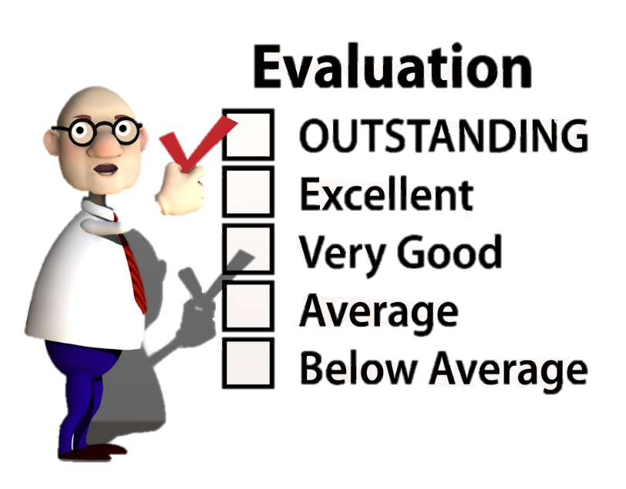
Workshop evaluation

Slide 106

ana.soares@undp.org
tina.tordjman-nebe@undp.org
THANK YOU

