Slide 1
The results of good evaluation: an example from Sudan
Elaf Zeinalabdieen

Slide 2
About the project
Project name: Implementing Priority Adaptation Measures to Build Resilience of rainfed farmer and pastoral communities.
Period: 2013-2016
Partners: HCENR, UNDP & GEF

Slide 3
What has been worked well
Improving access to reliable water sources
Introducing drought resistant varieties of animals and crops
Building the capacities of the targeted communities/ project’s staff
The awareness of women groups was enhanced
Lessons learned and emerging best practices captured, documented and disseminated

Slide 4
1st success story A new hope for women
“Our life became easier and less
struggling because of the project”
Economic benefits
Social benefits
Environmental and health benefits

Slide 5
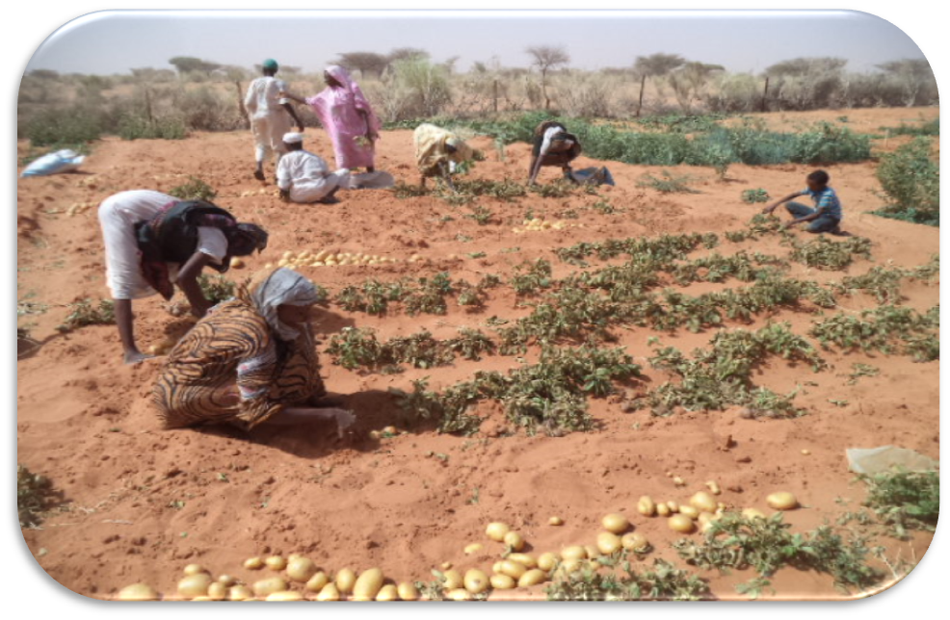
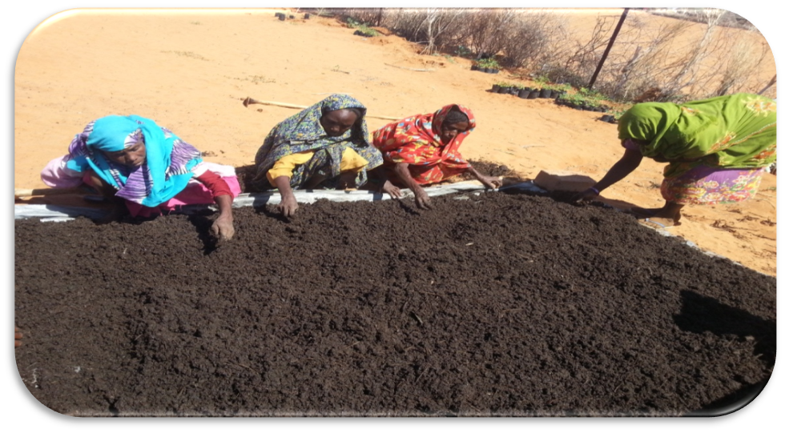
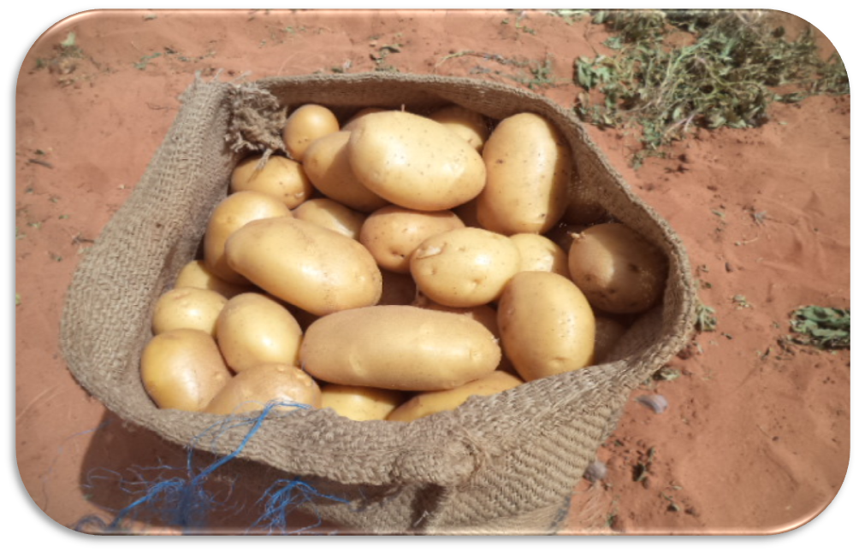
2nd success story Harvesting the good land

Slide 6
Challenges
Political
Environmental
Social
The current political unstable condition.
Weakness of governmental institutions.
Conflicts related to leases of land to foreign investors.
Shortage of supporting policies and legislation.
The use of biomass for domestic energy.
shortage of environmental data.
Migration problems.
Resource based conflicts

Slide 7
Recommendations
Improve the environmental governance system.
Enhance the knowledge of the communities with knowledge + technology.
Partnership with local institutions can expedite the evaluation processes.
Evaluation must be done by internal, external evaluators and communities.

Slide 8
Thank you
Elaf Zeinalabdieen
elafzeinalabdieen.ez@gmail.com

