Slide 1
National Evaluation Capacities Conference ( NEC) 25-28October, 2022 ITC ILO Turin , Italy
PREPARED BY
Mr T. CHAPARADZA:
ZIMBABWE

Slide 2
BUILDING ROBUST EVALUATION POLICIES FOR NATIONAL EVALUATION SYSTEMS
Let me start by introducing Zimbabwe and Africa for ease of following my presentation
Zimbabwe is found in southern part of Africa next to South Africa
It has a population of 15 178 979 and measuring 390 760 square km
Zimbabwe is endowed with 40 different minerals and offers great investment potential in mining, agriculture, tourism, construction and many more

Slide 3
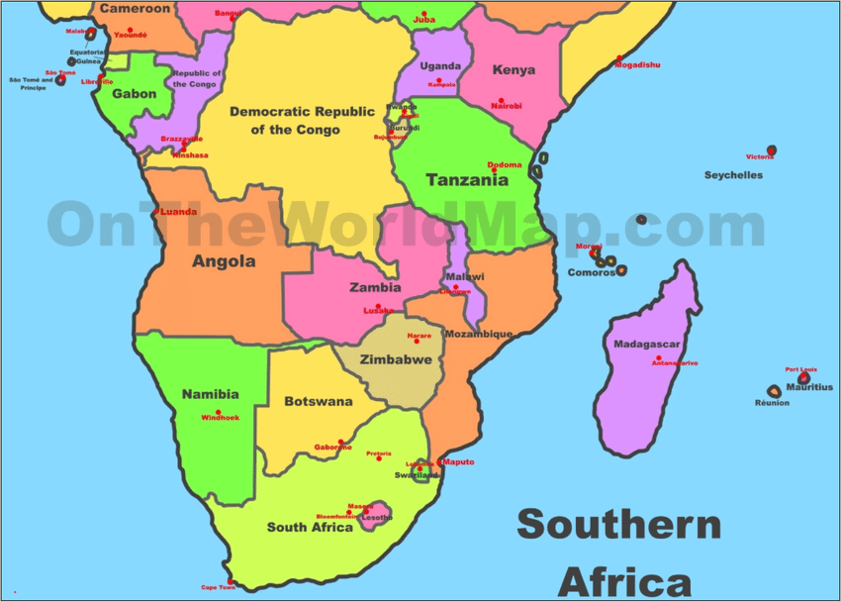
Map of Africa and Zimbabwe

Slide 4
The Citizen
Citizens evolved over time from Medieval Stone Age to Industrialization Age
Enlightened citizens and put pressure for service delivery and accountability by Governments (Depletion of Natural Resources)
Hierarchy of Citizens and pressure organisations emerged to oversight their interests
Birth of international, continental , regional and domestic institutions to address the citizen needs and wants
Development Planning and Management of Development Results became a common agenda in public discourse

Slide 5
Development Agenda
Global, continental, regional and national development plans came into being
Targets were set at each level to guide nations and create unity of direction for governments
Development Results Frameworks at appropriate levels were crafted
All efforts were unanimously agreed to be targeted at key fundamentals of life to the likes of

Slide 6
Development Agenda continued
Hunger and poverty eradication
Peace and security
Women, gender and children
Food and nutritional security
Governance
Environment
Education
Health
Climatic Change and Disasters etc

Slide 7
14 Grouping of Citizens Demands
1. Economic Growth and Stability
2. Food and Nutrition Security
3. Moving up the value chain & Economic Transformation
4. Health and Wellbeing
5. Infrastructure and utilities
6. Housing Delivery
7. Image Building & International Engagement & Re-engagement
8. Governance
9. Human Capital Development
10. Environmental Protection, Climatic Resilience & Natural Resource Mgt
11. Social Protection
12. Digital Economy
13. Devolution
14. Youth, Sport and Culture

Slide 8
Building a Robust Evaluation Policy
Evaluation by simple definition is reflecting whether our performance is addressing the citizens’ felt state of deprivation or exposure
The best OUT of evaluation can only be realised when its robust enough to bring the CITIZEN at the centre of development planning and provides feedback from the citizen comprehensively to guide planners, executors of policies, programmes and projects and the evidence-based decision makers

Slide 9
Key Tenets to consider
A robust evaluation policy does not come by itself , there are key fundamentals to consider such as :
a) Enabling Environment- There should be a political will at the highest levels to accept and embrace evaluations. Once evaluations are misconstrued and abused as instruments to pursue and expose key politicians , resistance becomes natural
There should be some guidelines to go with the evaluation policy spelling out the details of formats, procedures, reporting flow and dispensing of the evaluation
There should a A National Development Plan informed by International, Continental, Regional and National Development Results Frameworks

Slide 10
Enabling environment continued…
The Development Results Frameworks are results chains with performance targets imbedded in them
There exists some Key Performance Indicators ( KPIs) to track them and generate reports to give update
The KPIs should be measurable and citizen centric

Slide 11
Continuation…..
b) Institutional capacity building- Evaluations without proper institutional arrangements may not secure traction and resounding support
A readiness assessment is critical to make sure the institutions have what it takes to sustain an evaluations led Government
It is critical to think on official data providing institution, else data without credibility spoils all the cause to effect a robust evaluation

Slide 12
Continuation….
In Zimbabwe, there is ZimStats which is mandated to provide basic information across sectors. They champion The Zimbabwe National Statistical Strategy
The issue of data instrumentalization is pivotal , as secondary data is critical in conducting evaluations by providing baseline information and data validation

Slide 13
Continuation….
c) Personnel Skills – The staff skills need assessment in order to ensure that there is smooth implementation and making use of evaluation findings besides deducing lessons learnt out of them
Skills to the likes of availing of potential areas for evaluation for consideration of Cabinet, which advises on areas it needs evidence based information for its use
The above is better referred to as Annual National Evaluation Work Plan-its developed from submissions from line ministries on key areas they want to evaluate in the coming fiscal year and consolidated for submission to cabinet

Slide 14
ZIMBABWE NATIONAL MONITORING & EVALUATION POLICY
Was launched in 2015 to drive IRBM
Aimed to foster a results oriented performance culture in Government
To harmonize the pursuit of international and regional commitments to the likes of SDGs and Africa Agenda 2063 and SADC Industrialization Policy
Chapter 2 , Section 9 (1) of the Constitution of Zimbabwe allowed the State to adopt policies that fosters efficiency, accountability, competence, transparency at every level of Government as citizens continue to demand quality service delivery

Slide 15
Policy Continued….
Was developed after a series of workshops with participants drawn from public service, parastatals, development partners, academia, civil society and many more
Purpose of the policy was to guide the implementation of government policies, programmes and projects in order to achieve effective and efficient service delivery
Provides definitions, norms and standards for conduction an evaluation as well as governance and accountability standards

Slide 16
Evaluation Guides
Calls for all gvt departments to embrace IRBM
Makes it mandatory to continuously monitor and evaluate implemented gvt policies, strategies, programmes and projects at least once its life time
Requires Evaluation Plans to be done in compliance with set standards and procedures
Spells out evaluation coverage ( each level of the results chain has to be covered)

Slide 17
National Development Strategy 1
It’s the Medium Term Plan for Vision 2030
It is comprised of 14 TWGs, each has a chairperson at the level of a Permanent Secretary
Each has set national targets( National Priority Areas) to pursue and report on
TWGs are supposed to meet quarterly to produce Reports for the National Joint Review Committee and Cabinet
The data generated from the TWGs as they report on their targets is informed by an annually drawn M & E framework is inputted into an electronic monitoring systems to generate electronic reports.

Slide 18
Whole of Government Approach
The above concept was embraced by the Government in an effort to ensure all government entities are operating at the highest level of efficiency possible.
Traditionally the M & E was restricted to Admin, Finance and HR issues ignoring the programming/line function where the real service delivery happens
At the centre of Whole of Gvt Approach lies the Tripartite comprised of OPC, Ministry of Finance and Economic Development and Public Service Commission
They all work jointly to ensure smooth functioning of Government
An IRBM Approach was adopted were all Ministries, Departments and Agencies submit their Annual Strategic Plans and Performance Update Reports to the tripartite

Slide 19
Continuation…
The Tripartite deliberate on the Reports before sending them up to the National Monitoring Steering Committee.
All Ministries, Departments and Parastatals Heads signed Performance Contracts and appraised annually
Best performers are rewarded

Slide 20
Current Hurdles
Policy compliance particularly allocating 3% of budget to Evaluations or 10% to M& E by Ministries is yet to happen
Competent staff to drive the cause are still thin on the ground
Continuous staff movements
The culture of utilizing Evaluation Findings need to be improved
Some TWGs continue to operate in silos
Evaluations are not for witch-hunting and is not similar to auditing function

Slide 21
Continuation Current Hurdles…
Data availability in some areas remains a challenge
Some KPIs are complex and difficult to measure besides having them outward looking
Lack of adequate tools of trade and reliable connectivity network

Slide 22
Battles that need to be fought
Availing resources for evaluation led governance
Improving the utilisation of evaluation findings to inform future programming
Storage of Evaluation findings for future reference
Developing bankable evaluations that clearly pursue a well defined development agenda
Establishing permanent structures for evaluations support

Slide 23
Realized Evaluations Benefits
Fostered unity of Direction and effective policy analysis and review
Assured Citizens of our efforts to deliver
Created a results orientated performance culture
It forced us to plan
Reduced risks of not meeting targets
Timely corrective action on areas not performing well
Exposes poorly performing areas and attributing factors

Slide 24
Realized Evaluations Benefits
Have promoted transparency and accountability
Allowed continuous reflection on whether things are being done right and answered whether there is still coherence with the Citizen targeted
Availed answers for many issues raised in public discourse

Slide 25
Realized Evaluations Benefits….
Evaluations availed comprehensive, reliable and timely data concerning a selected area of focus by Cabinet, which will then decide or appreciate the impact for a pursued policy, programme or project even feedback on general public service delivery.
Allowed us to get the VOICE of the beneficiaries and their recommendation.
Evaluations have brought with them a lot of learning and knowledge construction for diverse clintele

Slide 26
Conclusion
The role of Evaluations in the post Covid-era where Governments are focused on reviving their battered economies, supply chains, programmes and projects cannot be overemphasized
The Covid global pandemic brought with it appallingly great dynamics in policies, programmes and projects programming
Evaluations led Governments stands great chances of durable citizenry support and longevity in power

Slide 27
Conclusion Continue…
Evaluations remain the spine of checking whether planned goals and objectives are being achieved
The effectiveness of all interventions is better addressed by evaluations
The pursuit of SDGs and Vision 2030 resides in effective Evaluations by Governments
No Evaluation , No Learning and No Evidence

Slide 28
THE END
THANK YOU
ALL
BE REMEMBERED

