Slide 1
Lessons from building evaluation capacities for Sectoral Evaluation: Lessons from the Indian State of Meghalaya
Sanjeev Sridharan
Bill and Melinda Gates Foundation

Slide 2
Some challenges of sectoral evaluation
Need to move away from a scorecard approach to sectoral evaluation
Mixtures of evaluation purposes
Lack of focus on building capacities—especially a focus on evaluation capacities to address inequities
The need to move away from project-level traps
The need for iterative adaptive learning

Slide 3
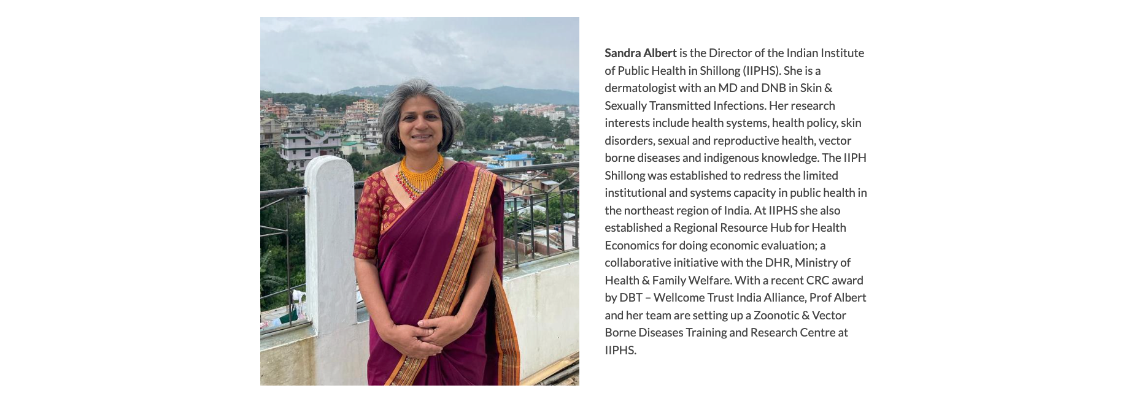
The Meghalaya Summer School as an experiment in State Policy Evaluation Capacity Building
1. Movement away from an exclusive focus on National-level—Both the Central and State Governments were involved
2. Who was in the room? Local leadership in health from all of Meghalaya’s districts. Principal Health Secretary and team, Development Monitoring Evaluation Office
3. Rethinking evaluation criteria: What do the participants see as progress in addressing problems?
4. Start with the problem-- move away from the intervention (solution) as the starting point
5. Problem driven iterative adaptation—towards heterogeneous theories of change and solutions—
Michael Woolcock led these sessions

Slide 4
The Meghalaya Summer School as an experiment in State Policy Evaluation Capacity Building
Continued ..
6. Evaluation Approaches
Theories of change
What data matter
Evaluation as navigation
Navigating towards solutions
Ecologies of evidence
Inequities
Sustainability
7. Performance Measurement
8. Learning from South Africa in Transforming Systems
9. Learning systems and learning processes
10. What's next: Capacity building in a single district

Slide 5
Implications for evaluation capacities of a Sector
LESSONS ABOUT CAPACITIES BUILDING
The need for creating spaces for cohesive solutions; cohesion as a dynamic problem
The importance of stewardship
Incorporating heterogeneities in contexts in policy evaluation
Capacity-building as a multilevel problem

Slide 6
Implications for the field
Towards a realist evaluation approach to sectoral evaluation: Incorporating diversities of contexts
Rethinking evaluation criteria
Collaborative spaces for iterative adaptations
Evaluation capacities for addressing Inequities and sustainability
https://meghalayaevaluationschool.com

