Slide 1
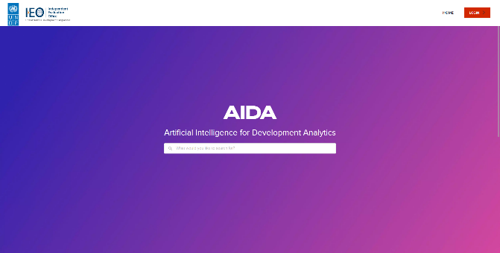
Aida Artificial intelligence for development analytics
27 Oct 2022

Slide 2
AIDA ORIGINS how the journey into artificial intelligence for development began
01

Slide 3
UNDP - EVALUATION RESOURCE CENTRE
Evaluation Planning
Report Upload
Track Management response
Evaluation Quality Assessment
Publicly & globally accessible system
Connected to Corporate systems for data exchange
Primary source for IEO AI Platform for Lessons generation
UNDP Country Offices
Headquarter Units
Funds and Programmes
ERC
ECOSYSTEM
Search Interface
Report and Data Extraction
Oversight Dashboard
Database with more than 6000 evaluations reports since 2002
Key functionalities:
Evaluation Planning, Report Upload and
Track Management Response
300 to 400 new evaluation reports added annually

Slide 4
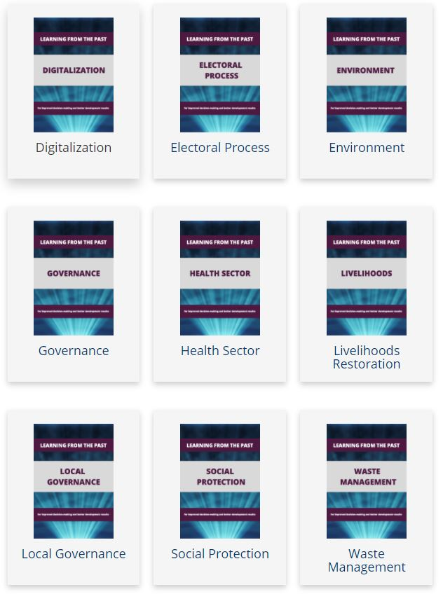
Reflections – Lessons from Evaluations in 2020 supporting the recovery from COVID-19
Extract lessons learned from past evaluations in response to previous crises

Slide 5
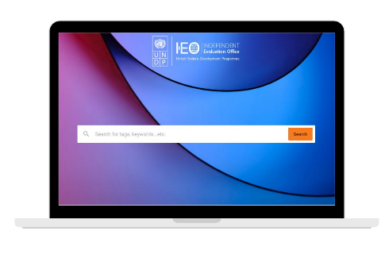
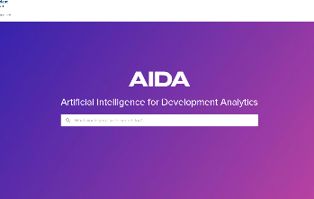
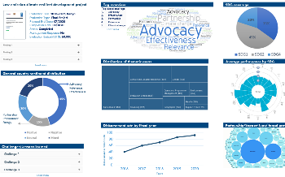
VISION
Phase 1
Create an AI-powered platform for automated extraction, labelling and search functionalities.
Phase 2
Develop analytical capabilities to perform sentiment analysis on evaluation evidence and use secondary data for insight generation.

Slide 6
What is AIDA and how does it work?
02

Slide 7
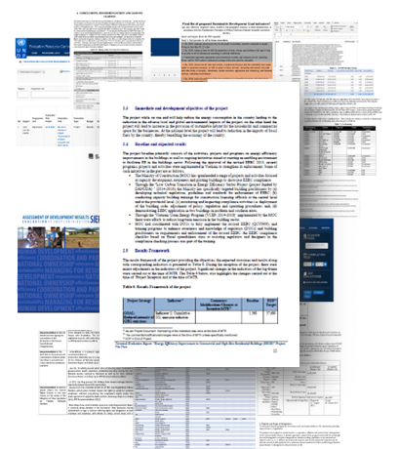
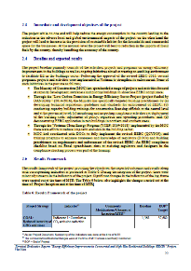
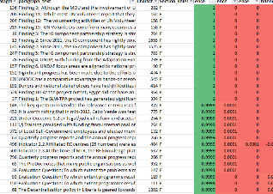
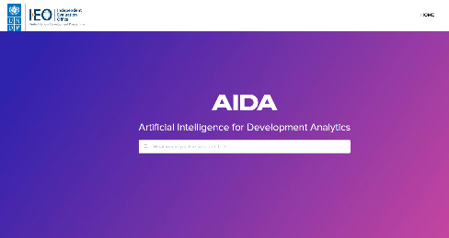
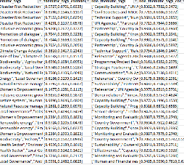
Phase 1 – simplified pipeline
AIDA Phase 1 objective:
Creating an AI powered platform for automated extraction, labelling and searching functionalities.
Data acquisition
Ingestion of more than 5,000 evaluation reports from existing database from ERC
Text extraction
AI driven extraction of key sections
Comprehension
Accurate labelling and categorization of extracted data
Human-in-the-loop feedback system to retrain the machine learning model
Search engine
ML driven search engine
Human-in-the-loop feedback system
Output filtering
Easy export to XLS

Slide 8
AIDA in practice
03

Slide 9
aida.undp.org
https://aida.undp.org/

Slide 10
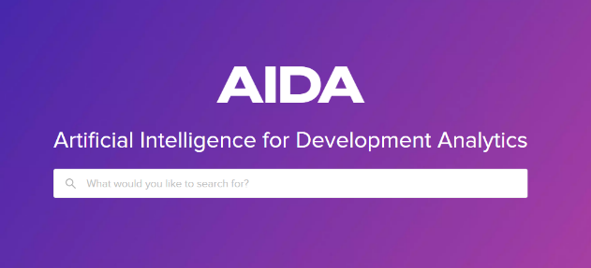
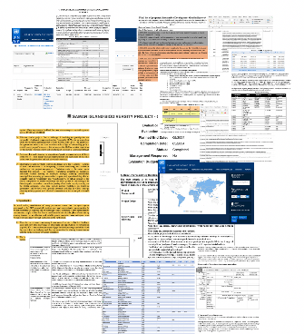
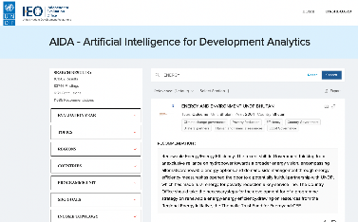
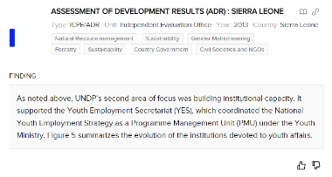
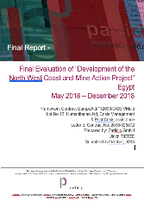
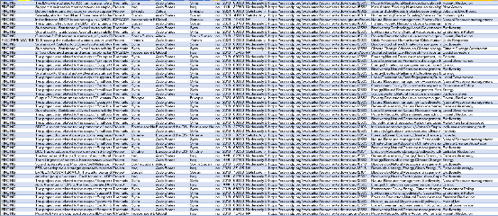
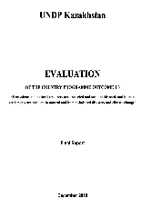
Making innovation work for M&E
AIDA helps project and programme managers, and evaluators expand their evidence base by searching existing data in a smarter, more efficient and innovative way.
By searching on the granular level of paragraphs, AIDA finds pieces of evidence that would not be found using conventional desk research.
AIDA enables evaluators to manage and analyze data more accurately, faster and smartly.
youth employment

Slide 11
Further development
04

Slide 12
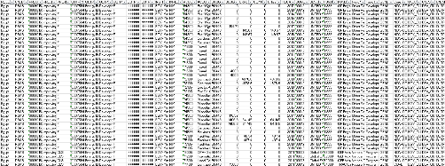
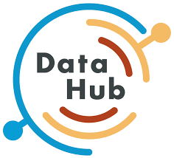
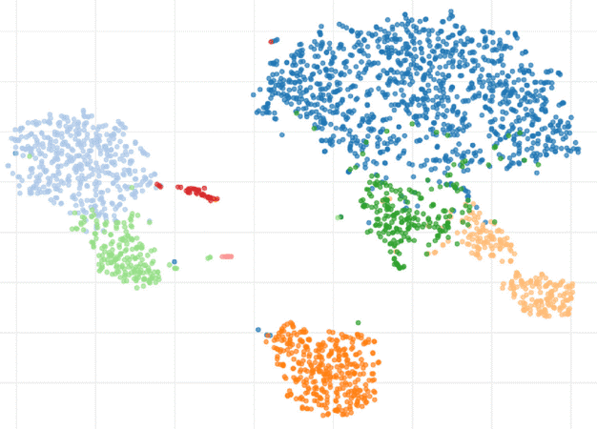
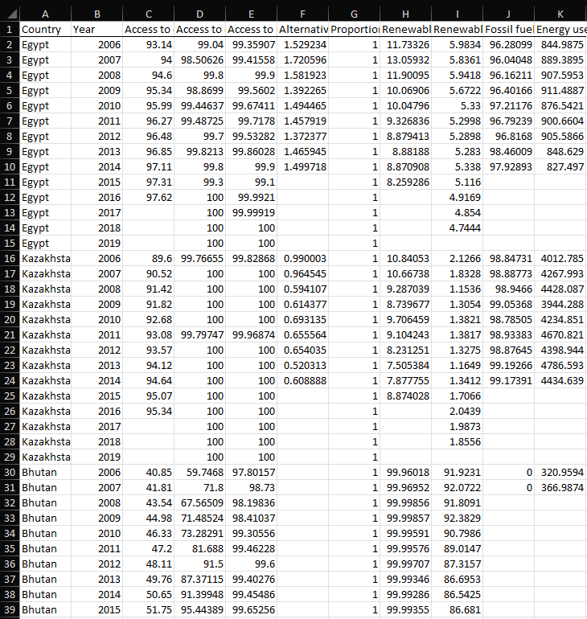
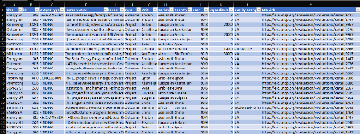
Combining AI/ML models to create insights
AIDA phase 2 aims to create insights by combining:
Primary data (evaluation evidence) with
Internal secondary data (UNDP programme data), and
External secondary data (country context indicators)
UNDP
Internal secondary data: UNDP programme data
AIDA’s insights will shed light on:
what programmes work (or don’t),
where and in which specific contexts, and
through what approach (e.g. direct vs. national implementation modality).
This will allow development professionals to investigate and understand why and how development works – enabling informed policy decision-making for effective human development.
AIDA
Phase 1 output
Primary data: UNDP Evaluation evidence
External secondary data: Country context data

