Slide 1
Evaluating SDG´s from a thematic perspective.
Costa Rican experience

Slide 2
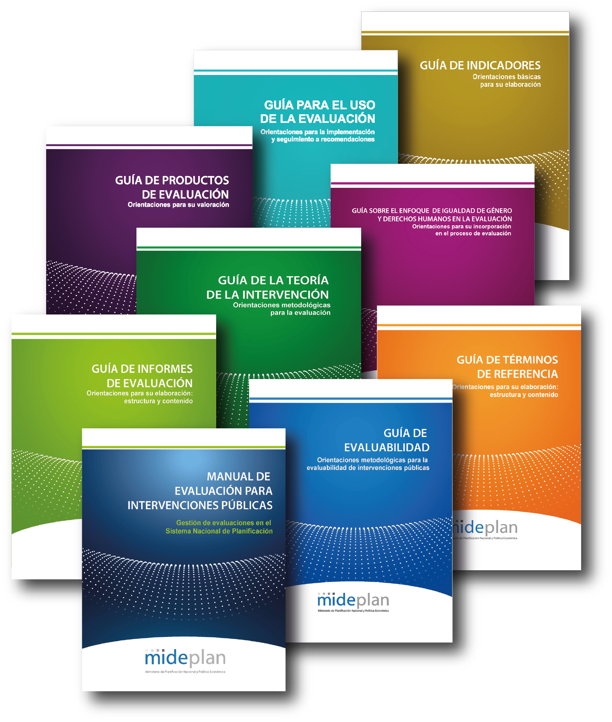
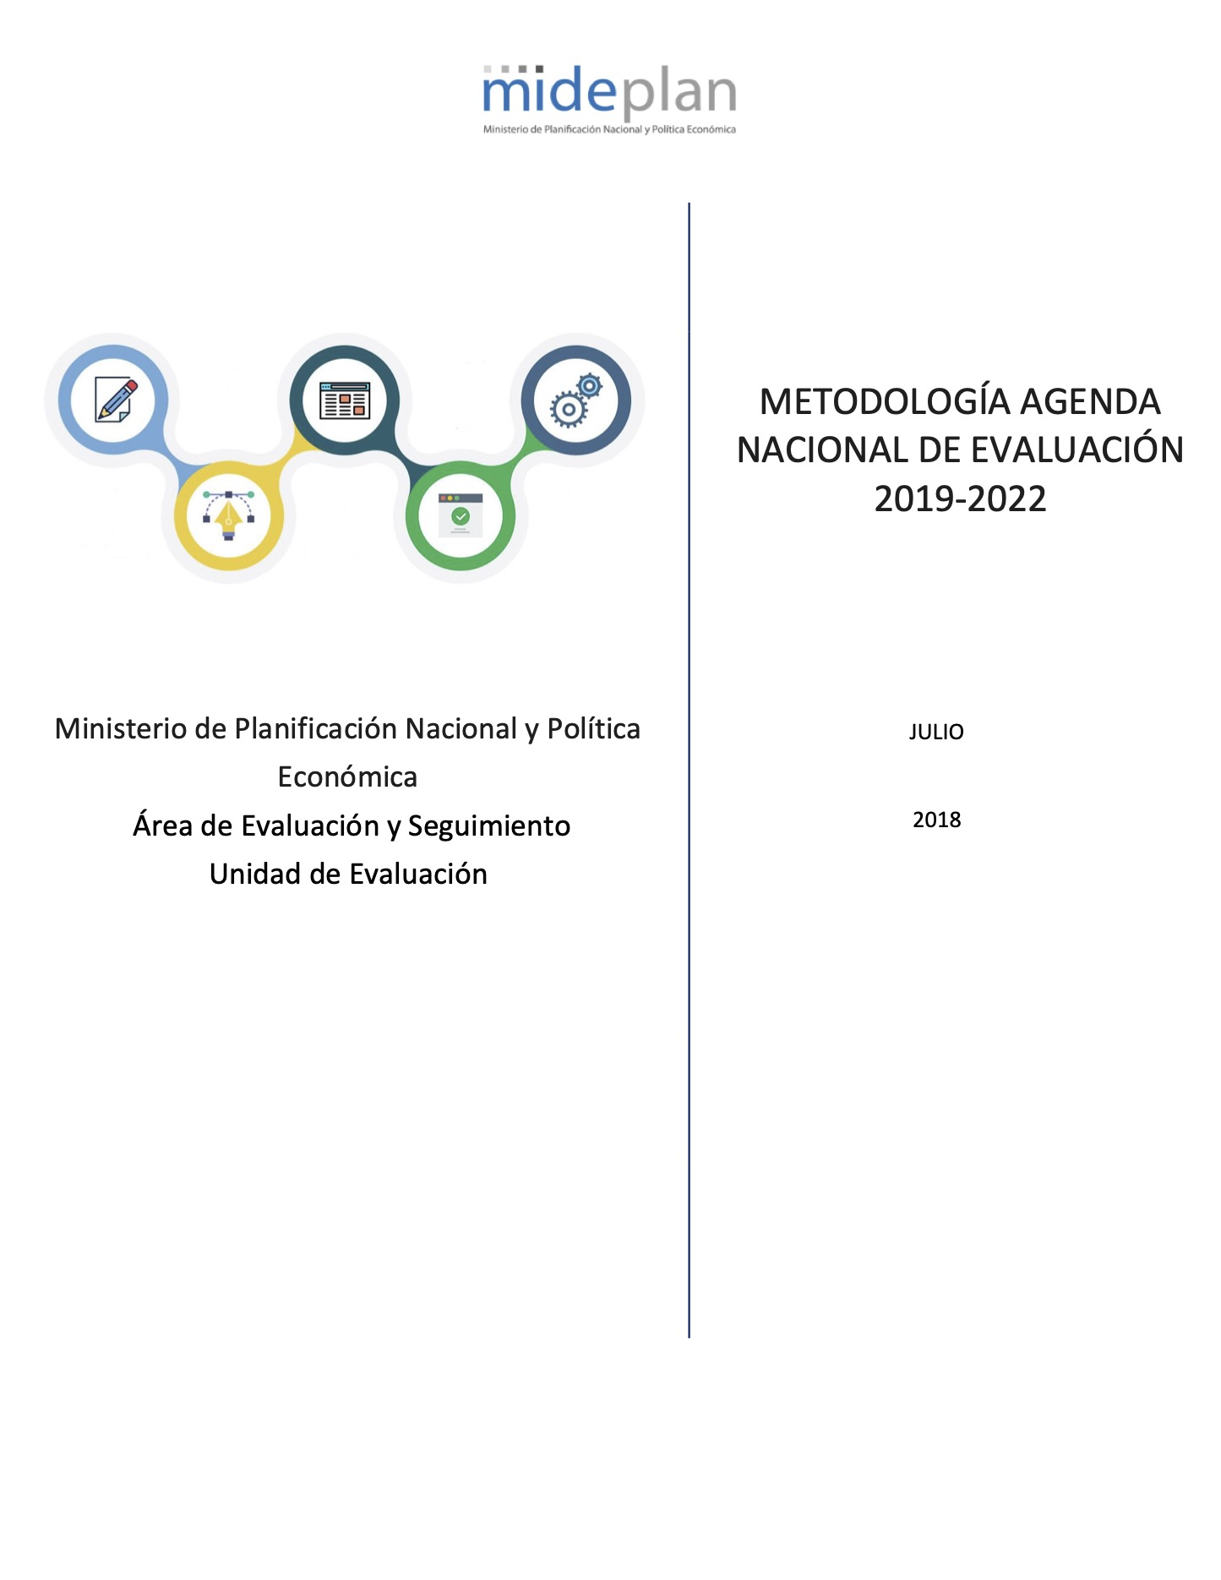
Framework
Regulatory framework for evaluation
Evaluation Planning Instruments
Methodological guidelines to manage evaluations
-Regulations at different levels,
-Mideplan: steering institution for the public sector.
-Alignment of the NEA with de NDP.
-Framing our work into a National Evaluation Policy.
To structure de evaluation process for public interventions.

Slide 3
How we included SDG´s and 2030 analysis in our evaluations?
Regular
approach
5 evaluations
Question link to “Relevance” criteria
Crosscutting
view
1 evaluation
Question link to principles of the 2030 Agenda
“Relevance” criteria
Aligment with planning

Slide 4
EVALUATION OF NON-REIMBURSABLE INTERNATIONAL COOPERATION IN BIODIVERSITY AND CLIMATE CHANGE RECEIVED BY COSTA RICA.
Notes:
Thank you Dirk. Today i will like to share the experience of
2010 and 2018

Slide 5
Why was this evaluation chosen?
1
3
Interest from the Area of International Cooperation (ACI) to review the management and results of non-reimbursable international cooperation (NRIC) in biodiversity and climate change (BioCC) received by Costa Rica.
Support from governmental authorities (Minister of Planning and President of the Republic).
2
4
Interest in reviewing the contribution made to fulfilling BioCC-related SDGs.
Inclusion in National Evaluation Agenda (ANE) 2019-2022.

Slide 6
Innovative elements for Costa Rica
Thematic evaluation
Country led evaluation
First thematic evaluation from the Costa Rican National Evaluation Agenda.
For the first time in the region, an evaluation is led out from the cooperation recipient country instead of the donor.
Sistematization
Links with SDGs
To collect good practices, faced chanllenges y lessons learned.
The central themes in the evaluation- climate change and biodiversity- were link with the 2030 Agenda and the Sustainable Development Goals.

Slide 7
How we did it?
WORK SESSIONS: INFORMATION NEEDS.
(what, what for, type of information, timeframe, topics)
1
2
WORKSHOPS TO DELIMIT THE OBJECT AND SCOPE.
The types of evaluation required were identified (processes and results).
CREATING INPUTS AND INITIAL MATRIX PROPOSAL.
Various documents were produced to put boundaries around the evaluation, generate process questions, and identify the needs of the study.
3
4
CHARACTERISATION STUDY AND BEHAVIOURAL ANALYSIS.
The need to carry out contracting prior to the evaluation was identified: the characterisation study and behavioural analysis.
5
CREATION OF FINAL MATRIX PROPOSAL AND VALIDATION.
Once all the information was complete, the work teams finalised the evaluation’s scope and delimitation, this time including results.

Slide 8
2030 Agenda and SDGs in our evaluations
Complying with the SDG require to guarantee that the institutions design policies considering the 2030 Agenda.
We must also foster advisory to institutions and stakeholders from different sectors (CSOs, business sector…) in order to set base lines.
This evaluation, due to its broad scope, findings and conclusions constitutes a starting point that can be developed in subsequent evaluation exercises.
Main
aspects
Notes:
1. … and this include the foresight of targets, probably the development of ex-ante evaluations that will enable a better formulation of policies, consequent with theory of change, in order to clarify where should non-state stakeholders may contribute, and being clear enough about policy outcomes that we want to achive.
2. for monitoring results, and set evaluability requirements that will enable more and better evaluations, considering SDGs contribution.

Slide 9
Muchas Gracias
unidadevaluacion@mideplan.go.cr

