Slide 1
Session D7
Transformational Change
Integrating Human Rights-Based, Gender-Sensitive and Feminist Approaches in National Evaluation Systems for transformational change

Slide 2
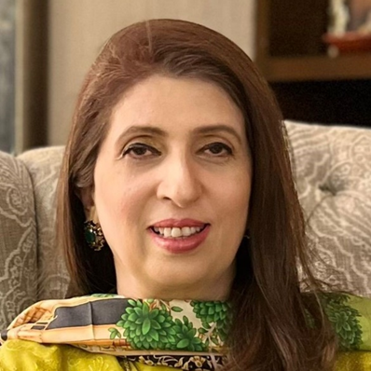
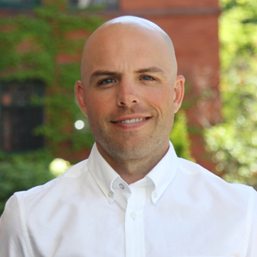
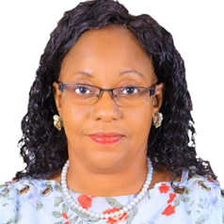
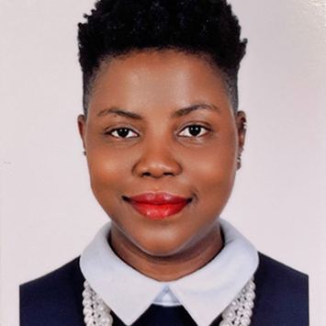
Dr Shabnam Sarfraz
Senior Advisor Social Sector & Development
Served as Member Planning Commission, Government of Pakistan
Mr David Marchesseault
Evaluation Manager
Global Affairs Canada
Dr. Angelina Mattijo Bazugba
Asst Professor of Social Policy and Dean/Director
National Transformational Leadership Institute (NTLI), University of Juba, South Sudan
Ms. Daniella Jacques
Présidente
Chambre de Commerce des Femmes Entrepreneures d’Haiti

Slide 3
Dr. Shabnum Sarfraz
Senior Advisor Social Sector & Development
Served as Member Planning Commission, Government of Pakistan

Slide 4


Transformational Change
Integrating Human Rights-Based, Gender-Sensitive and Feminist Approaches in National Evaluation Systems for transformational change?
Case Study of Pakistan
Dr Shabnum Sarfraz
Senior Social Sector Development Professional
Former Member Social Sector & Devolution,
Ministry of Planning, Development and Special Initiatives
Government of Pakistan

Slide 5
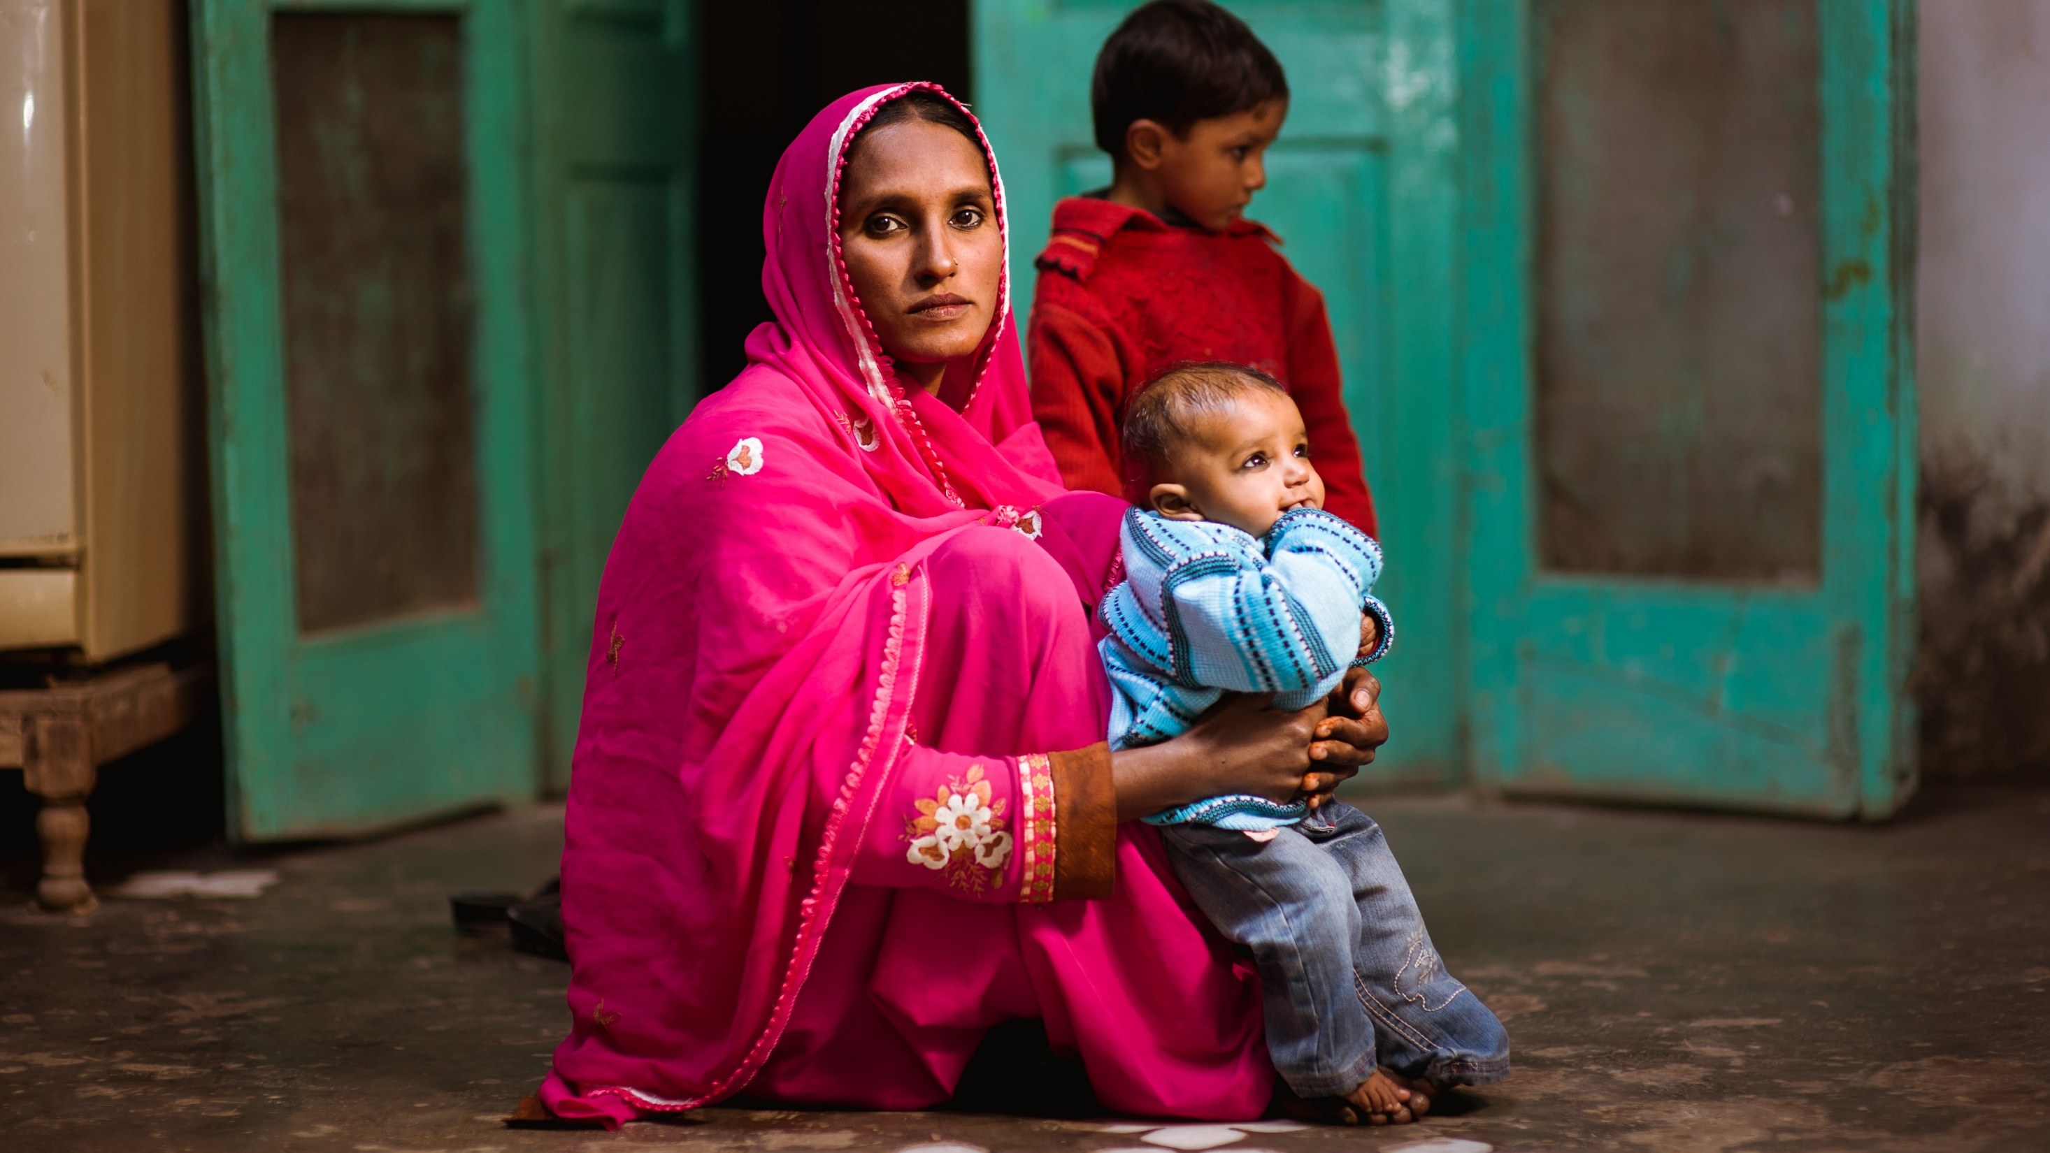

@ShabnumSarfraz
GENDER STORY

Slide 6
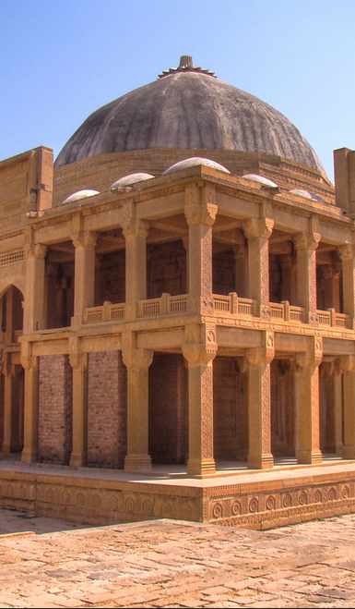


Population (Millions) | 229
Sex Ratio Men: Women | 1.05 : 1
GDP Per Capita (USD) | 1,547.85
Human Development Index | 0.562
Literacy Men (%) | Women (%) | 70 : 48
Labor Men (%) | Women (%) | 68 : 22
Notes:
We are a country with 112,5 million (49.2%) plus female population.
48% of the women are literate as compared to 70% of the men

Slide 7
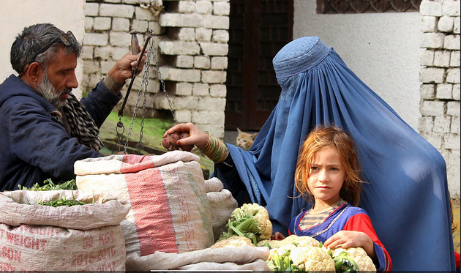
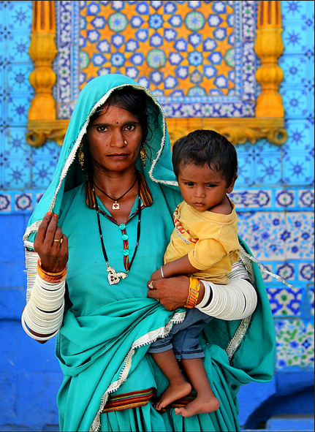
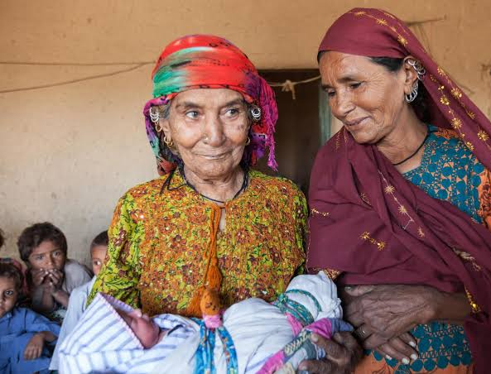
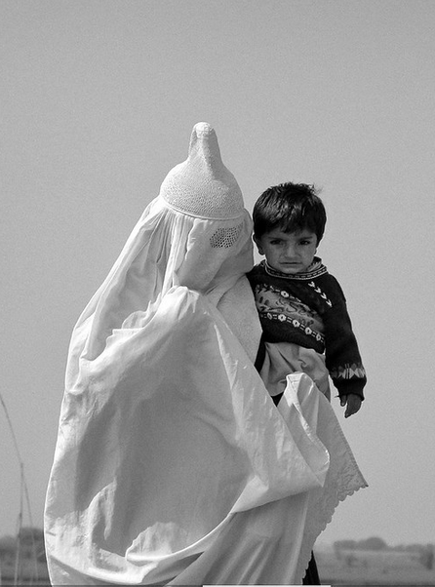
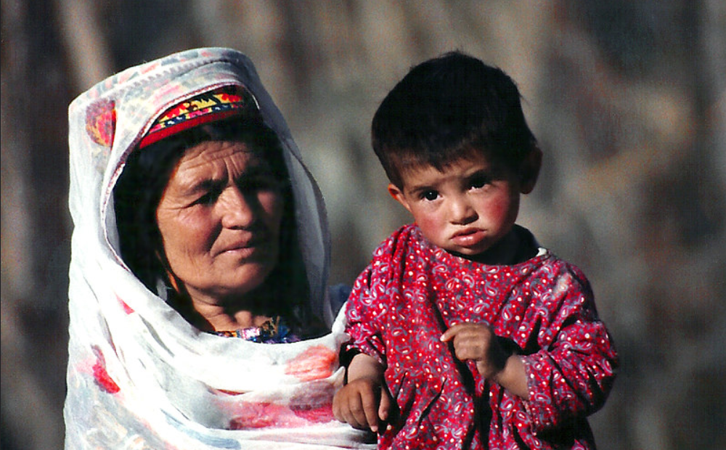
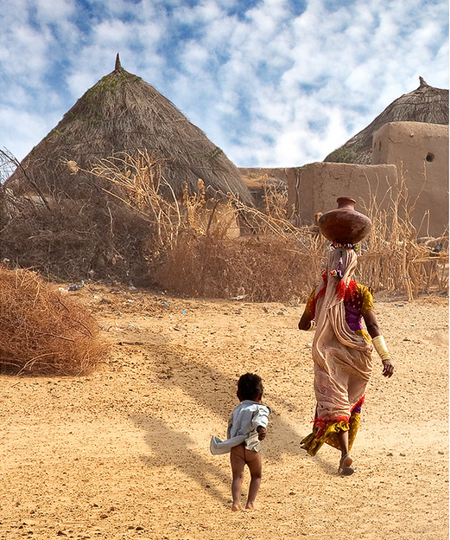
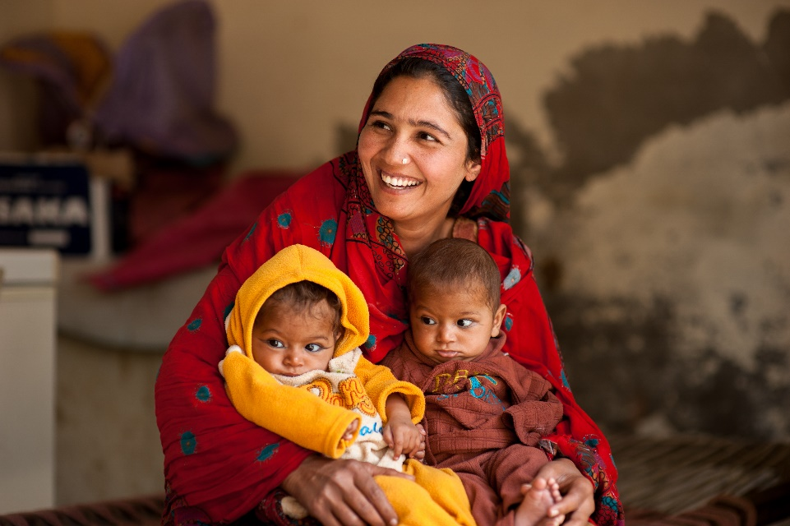
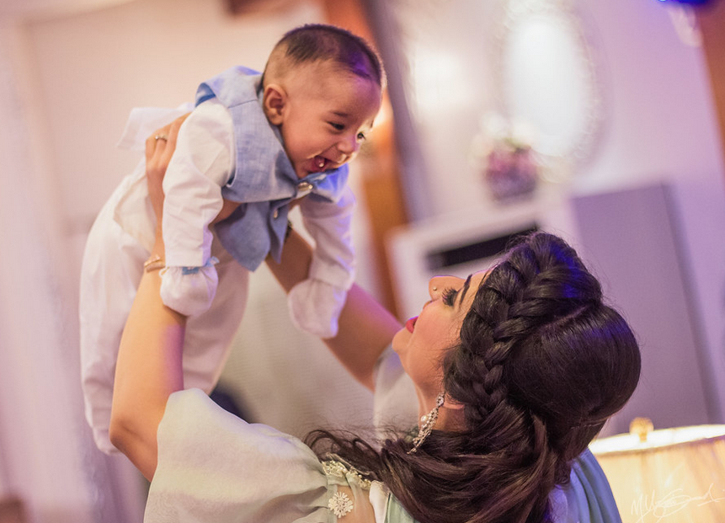
Notes:
These are the most probable images of women that are likely to come to your mind about the women in Pakistan

Slide 8
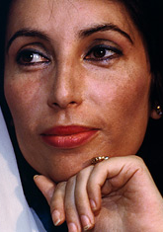

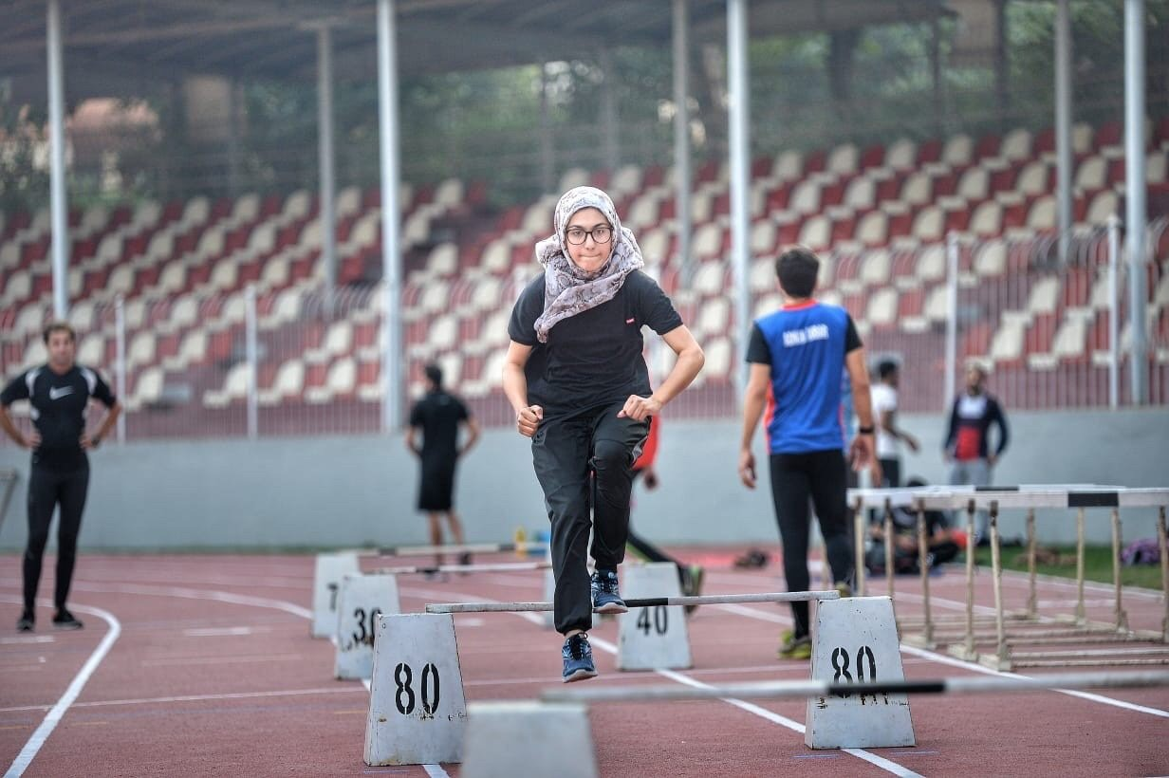


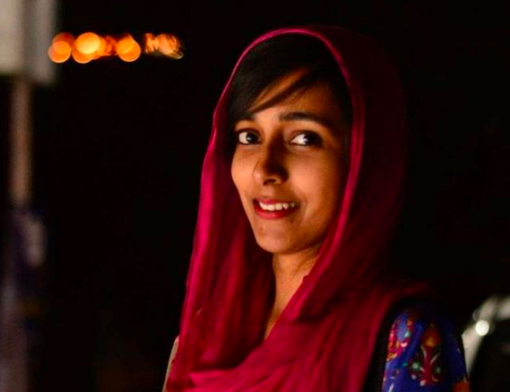
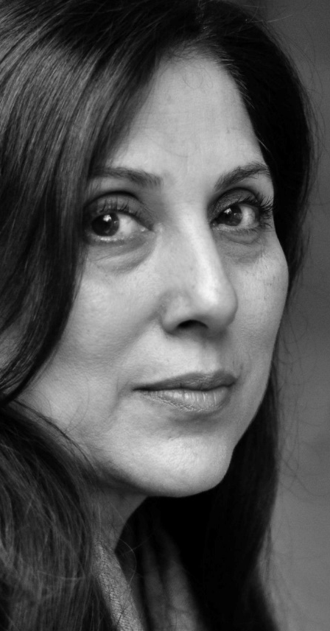
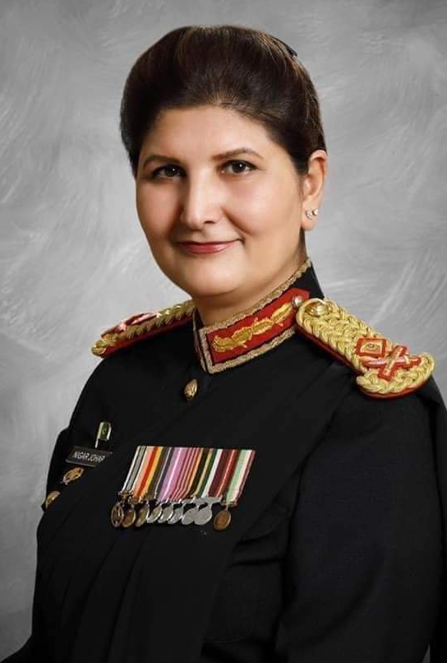




The
Women
Of
My
Country
Notes:
Less is known about these iconic women who excelled and have gained global recognition

Slide 9
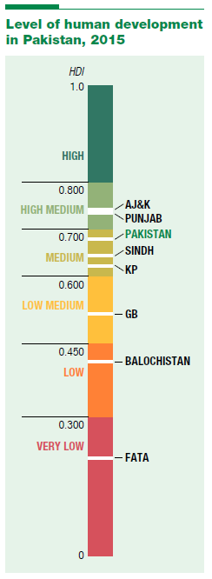
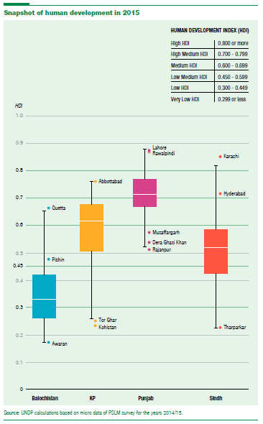
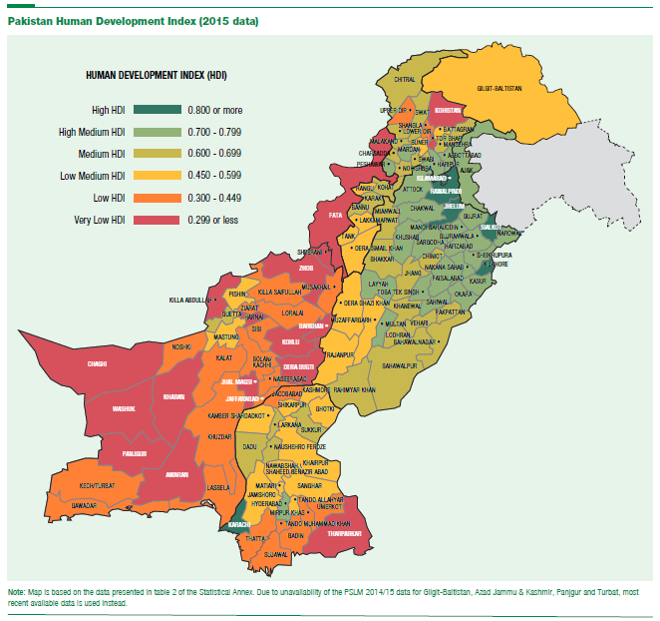
Inter-Country Disparities across Provinces
Learning about the differences across Provinces, within Provinces and the Bias of Averages
Notes:
As diverse as these women, Pakistan is not one average number. Huge disparities exist across provinces, and then within provinces across sub districts.

Slide 10
Gender Inequity – The largest untapped opportunity
With 10.5 Million OOS Girls in the country, Pakistan has 8% of the global share of all girls not going to school
With 32 million of primary school age girls not going to school, 17% are in Pakistan (5.5 Million)
48 out of 100 young girls not in education, employment or training
Notes:
According to UNESCO estimates, around the world, 129 million girls are out of school, out of which 10.5 million are in P
Of the 32 million of those in primary school age, 5.5 million are with us.

Slide 11
Sub national contribution to the 8% of global burden of OOS girls
Notes:
Conscious efforts are consistently being made to make the sub national governments aware of their contribution to the national and global burden of OOS girls

Slide 12
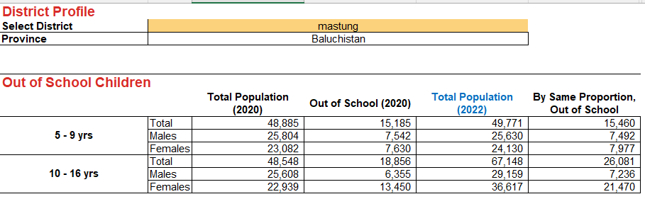
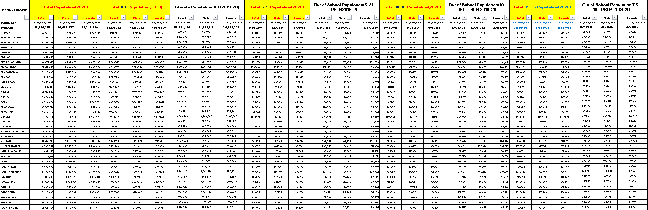
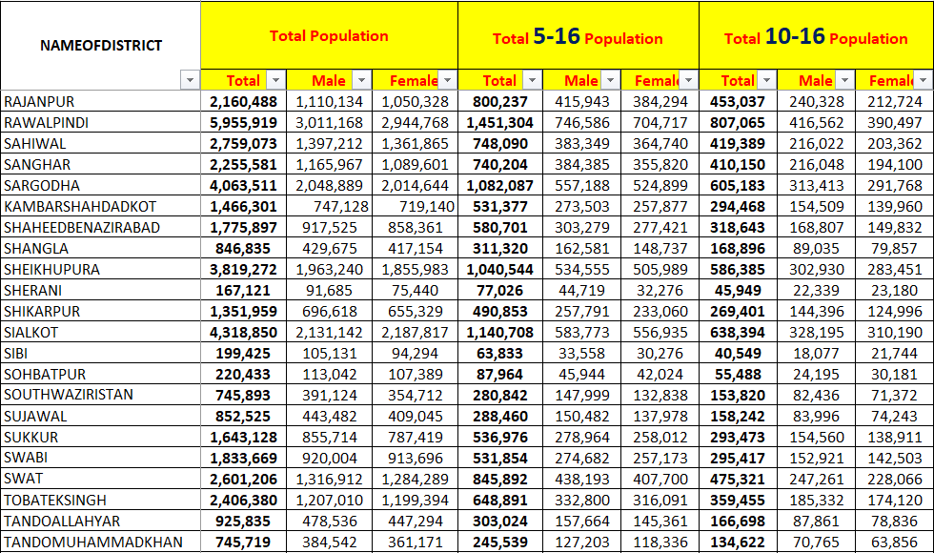
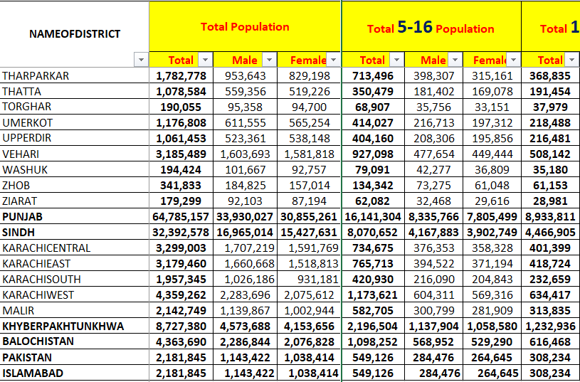
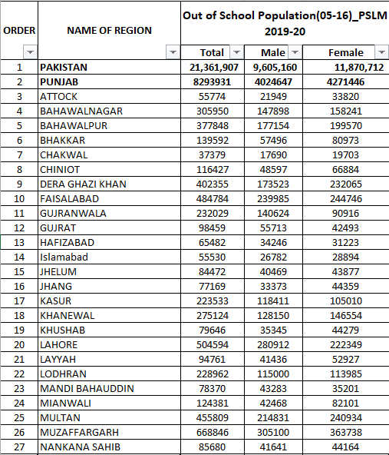
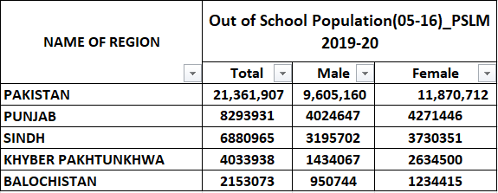
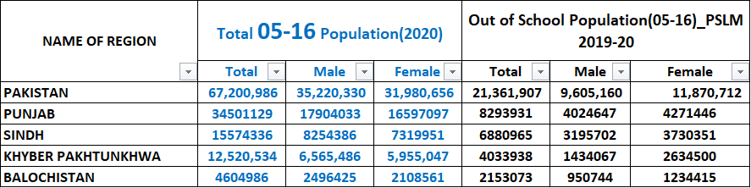
Targeting Out-of-School Girls Proportion
Notes:
We first started with provincial OOS proportions of 5-16. Since the absolute number made little sense, we went on to get 2022 population projections based on 2017 estimates. In the next stage, to target districts, we asked for district numbers of OOS children age 5-16. Again, we needed the district wise population projections.
This was an extensive exercise requiring multiple iterations with the Bureau of Statistics. Once we had district wise population and 5-16 OOP, we were confronted with a new plan – understand the primary and the secondary gap, i.e. differentiating between 5-9 and 10-16 years age groups. This time we began with first confirming population projections of each age group for the districts. We then got the OOS proportion for each district. We also tabulated the 10+ population group projection to tally with population literacy rate. Based on these backend workings and provincial confirmations, we were able to put together a dashboard.
We could select any district and see the total proportion of OOS students.

Slide 13
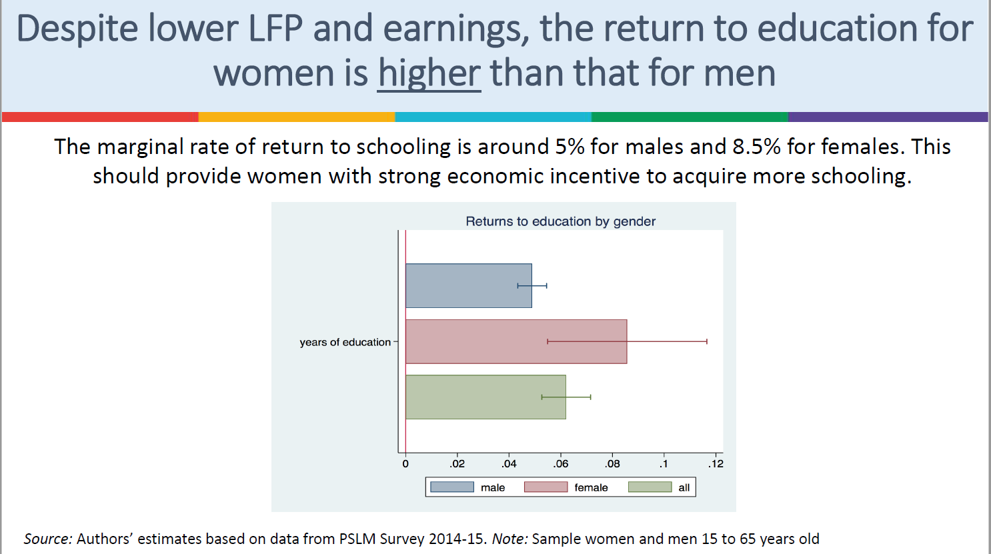
Identifying ‘Other Languages’ to speak to the stakeholders
Notes:
For decades, gender advocates have tried to highlight the violence experienced by the women in an attempt to promote gender parity. In recent years we changed the narrative to highlight the return to education for girls which is 8.5% as compared to 5% for boys

Slide 14
Estimating the “cost” of OOSC for Pakistan
Source: UNICEF Pakistan 2022
Notes:
With support of UNICEF the cost of OOS children in Pakistan was recently computed and we were successful in getting the agenda getting due attention

Slide 15
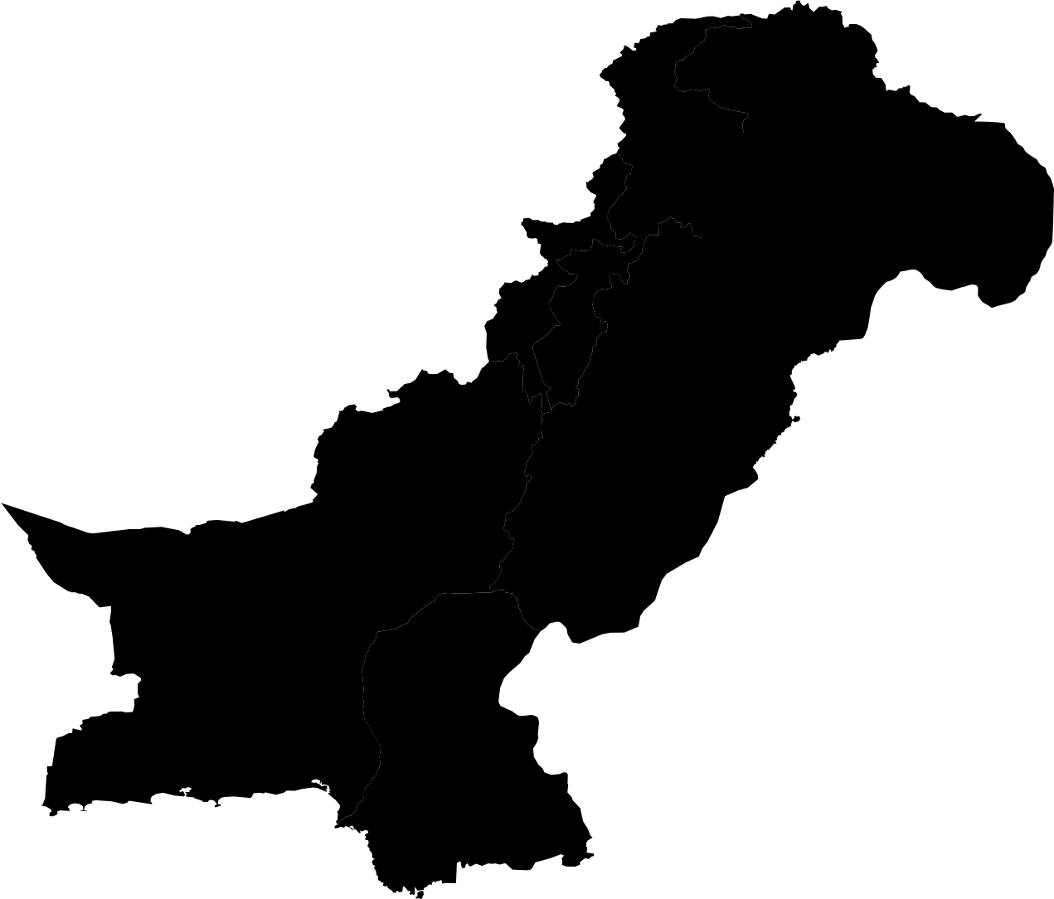
Gender Equality highlighted as a priority in the digital youth survey
Notes:
In a digitized survey conducted amongst the youth which make up 65% of the country, gender mainstreaming across policies and programs was identified as a priority initiative for the govt to pursue

Slide 16
Gender Inequity – The largest untapped opportunity
With 76 million women of working age Pakistan has a LFP for females of only 22%
32% are paid while 52% are unpaid family workers equating to 2.6% of National GDP
Female share in formal sector is 34.3% vs 65.5% in the informal sector
11% women working in public sector with only 2% at senior leadership level
7th country with largest gender gap (31.6%)
153 / 156 on Global gender Parity Index
Wage gap is 50% costing PKR 500 billion annually
With 46.7 million women registered as voters (18+) only 46% turned out at the last election
Notes:
LFP for the 76 million women of working age in Pakistan stands at 22%
Majority occupy the informal sector with a huge wage gap
Turn out of women in last elections was only 46%

Slide 17
Percentage Distribution of Employed Person by Major Occupation
Major Occupation | Male | Female | Total
Labour Force Participation Rates (%) | 68 | 20 | 44
Unemployment rates | 5.8 | 5.1 | 8.3
Managers | 95.07 | 4.93 | 100
Professionals | 66.79 | 33.21 | 100
Technicians and Associate Professionals | 89.90 | 10.20 | 100
Skilled agriculture, forestry and fishery workers | 62.17 | 37.83 | 100
Elementary occupations | 78.21 | 21.79 | 100
Source:- LFS 2017-18
Notes:
Recent survey depicted only 5% women being in the managerial role despite gender gap being closed at the tertiary education level

Slide 18
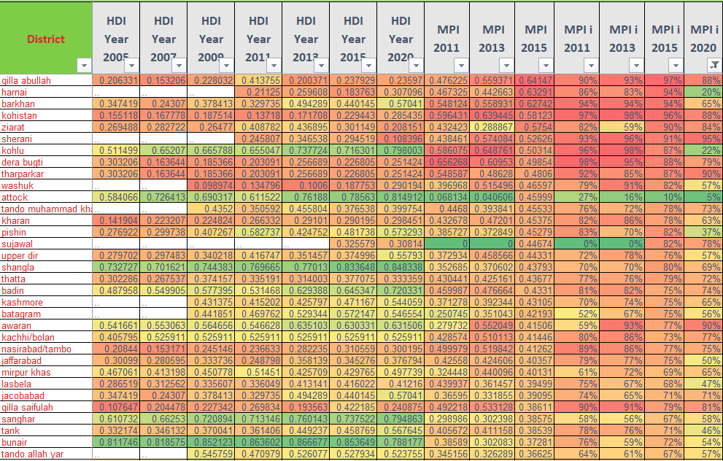
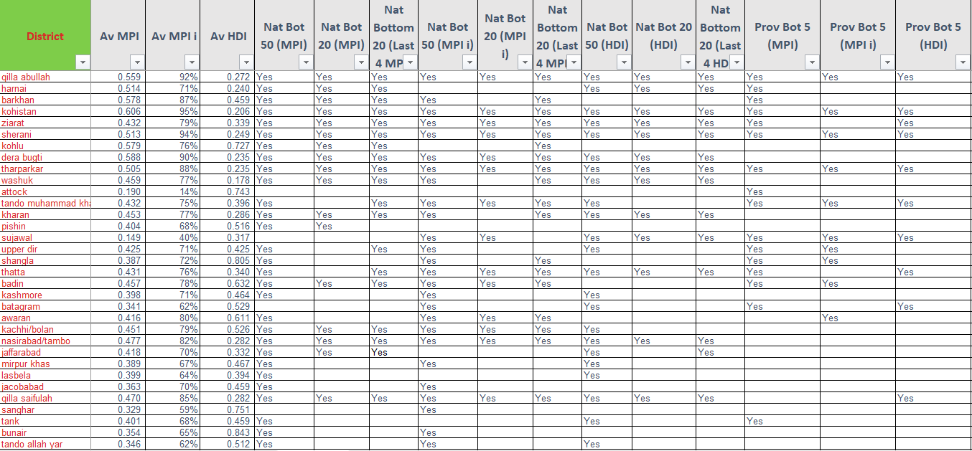
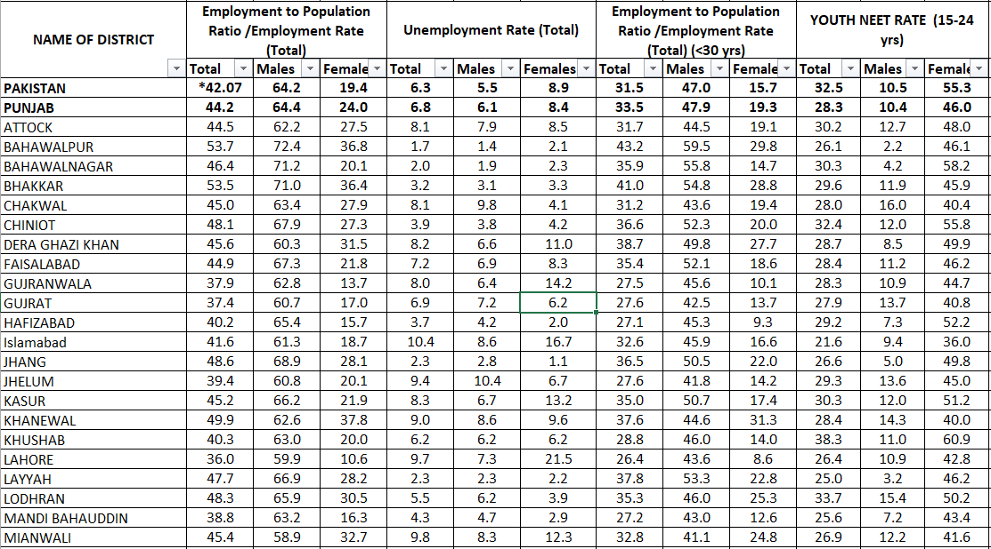
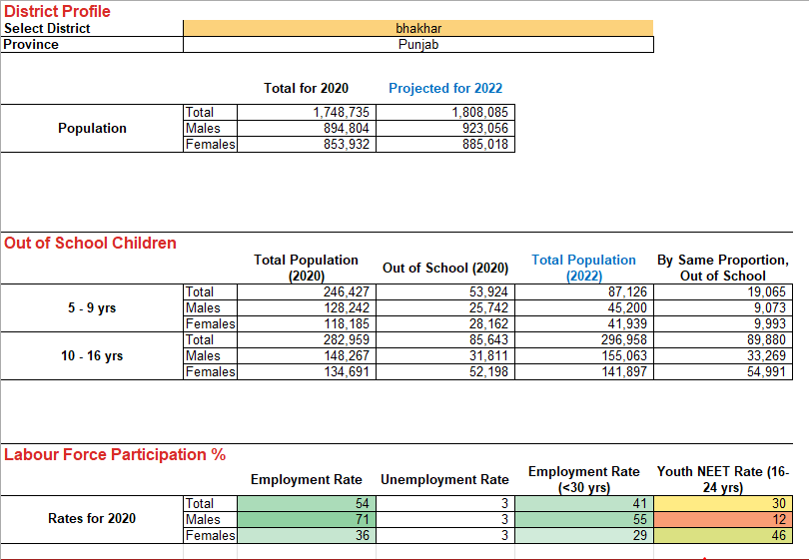
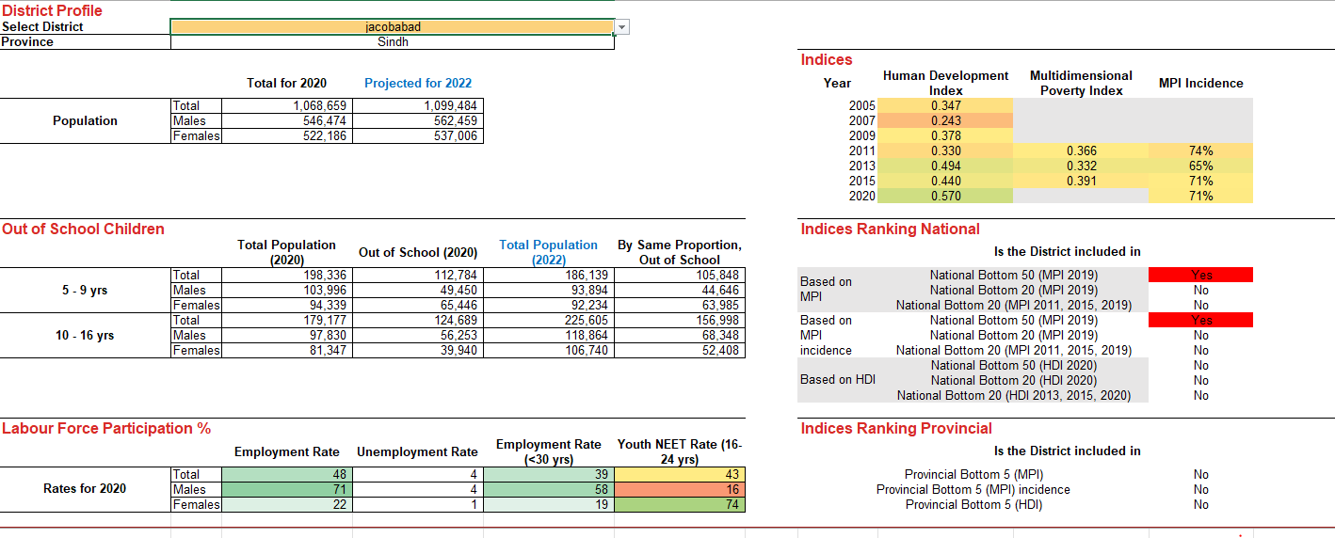
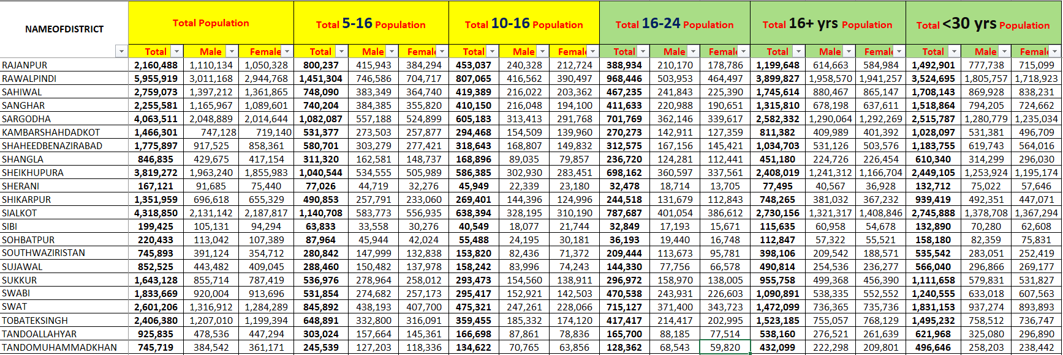
Targeting Labour Force Participation
Notes:
Learning from this exercise for OOSC girls, we moved to collate the labour force participation rates of women, as the next high level policy target for the Ministry. We first expanded on the population projections to include age groups used in labour force participation ratios such as 15-24 for NEET or 10+ for labour force participation or dependency rates for population under 30 yrs of age. Next we tabulated employment rate, unemployment rate, employment to population rates and youth NEET rate. In order to identify struggling districts, we decided to bring it all together. Now we had a joint dashboard reflecting of OOS proportions, labour force participation as well as population projections. We then decided to introduce the layer of human development and multidimensional poverty rates by districts.
We began with the tedious task of matching districts’ names first to be able to correlate and cross the data e.g. district Jhelum spelled as jehlum, jehlam, jhelam..with each survey spelling regions differently. We plotted HDI and MPI trends since 2005. Based on these trends, we were able to tabulate National Bottom 50, Bottom 20 districts, Provincial Bottom 5, consistently poor-performing districts etc. All of this was incorporated in a single screen dashboard linking multiple databases to extract information from. This dashboard now captured the latest status of OOSC and labour force participation of women, as well as ranking of the district vis-à-vis their HDI and MPI, making it easier to prioritise districts for girl child education and labour reforms in each province as well as overall.

Slide 19
Back-of-the-envelope estimation for Pakistan (Impact of female LFP)
  Productivity improvements are important, but mobilizing inactive workers (primarily women) could be more effective (Female LFP is 22%, while Male LFP is 82%)
  A 10% change in value-added due to labor reforms if driven by just physical investment would require 13% increase in capital rents (assuming labor in VA is 30%), although investment driven growth would likely be labor displacing
  Five scenarios considered ( Shifts in female labor force participation (FLFP) rates & Changes in average wages)
Scenario | Impact on Value Added in GDP (%)
Productivity rises by 5% | 1.40
FLFP rises from 22% => 30% | 2.16
FLFP rises from 22% => 50% | 7.70
Productivity increase + FLFP rises from 22% => 30% | 3.67
Productivity increase + FLFP rises from 22% => 50% | 9.49
Notes:
Economic evaluations supported by world bank have helped us bring gender mainstreaming to the highest policy tables. The slide reflects five scenarios whereby GDP is enhanced by increasing the LFP

Slide 20
Gender Disaggregation at different career stage in federal ministries
Out of 129198 Employees , 89% are Males and 11% are females
Notes:
Gender focal points have been notified at every ministry and in a survey rolled out by them, there are only 11% females amongst the total number of staff at the federal level.

Slide 21
Gender Disaggregated Data of Staff Promotion (Jan-Dec 2021)
Notes:
Out of the total staff promoted between Jan 2020-Dec 2021, 20% were females.
A sharp declining trend of females promoted at higher scales was noted

Slide 22
Gender Conducive Work Environment in Public Sector Offices
Only 18% have a dedicated parking space.
Only 15% have pick & drop facility.
Only 35% have a day care facility.
Only 28% have a common room.
Only 54% have a prayer room facility.
Only 22% have female dedicated space at
Cafeteria.
Only 11% have a female only cafeteria.
23% don’t have female only toilets
Notes:
Gaps in female desired facilities were identifed across all federal ministries and finances are committed to address the same in the coming year.

Slide 23
Achieving work-life balance biggest barrier to career advancement for 49% of these women
Almost 1/3rd of the respondents cite competing responsibilities of family, and not having day care facilities as a hurdle
45% rendered lack of mentors as a barrier
Notes:
In another survey conducted across 80 plus women leaders of Pakistani origin, achieving work life balance and lack of mentorship and training opp were listed as the biggest constraints to climbing the career ladder

Slide 24
Works to achieve Gender Equity in Health Workforce in Pakistan
Launching Women in Global Health Pakistan Chapter – The first WGH Chapter in Asia
First ever 1000 dedicated scholarships for Nursing and Midwifery with the Ministry of Federal Education
Year of Nursing and Midwifery 2020
WGH Pakistan Power Delegation – 14 Leaders for Generation Equality Forum 2021
Notes:
Women in Global Health Pakistan Chapter was launched in 2019 as the first chapter in South Asia to promote gender transformative L.
1000 faculty development sch were rolled out amongst the nurse professionals in the year 2020

Slide 25
Policy Initiatives at the Planning Commission 2020-2022
Pakistan’s first National Gender Policy Framework unanimously endorsed and launched on 8th March 2022
Gender Action Matrix for 2022-2023 developed and regularly reviewed
Gender Accelerators being established at the Planning Commission and the provincial P&Ds
102 Gender focal persons identified in all the ministries
Subgroup of Advisory Committee on Gender at the Planning Commission notified
Constitution of a technical working group for streamlining computation of national gender indices
SDG 5 (Gender) presented in the 1st and 2nd Voluntary National Review (VNR) at the UN High Level Political Forum (HLPF).
Investment Case for Gender developed for NEC
Gender Study rolled out to all federal ministries
Notes:
The slide enlist some of the recent policy initiatives spearheaded by the PC, the highest policy and coordination forum in the country. These include launch of NGPF. Estab of Gender Accelerators in national and sub national planning depts.
102 Gender focal persons identified in all the ministries
Subgroup of Advisory Committee on Gender at the Planning Commission notified to guide gender mainstreaming in dev programs
Technical working group is looking at streamlining computation of national gender indices
SDG 5 (Gender) presented in the 1st and 2nd Voluntary National Review (VNR) at the UN High Level Political Forum (HLPF).
Investment Case for Gender developed for the highest decision making forum i.e. the NEC

Slide 26

COVID-19 Secretariat
Int’l Experts
CERP
National Academic and Research Institutions
Strengthening Partner Coordination & Data Ecosystem
Harvard Global Health Institute
Indepth Analysis by UN Partners in relevant thematic areas
International Think Tanks
Level 1– Review by COVID19 Secretariat
World Bank
Level 2– Review by Intl/Nl experts
ADB
Harvard Kennedy School
Level 3 – Review by Ministries
PIDE
Notes:
It indeed takes a village to do something right. A MULTI LEVEL APPROACH was critical to achieving this.
The Planning Commission served as the secretariat for working along not only government counterparts, but also development partners, academia and research institutes, policy think tanks both nationally and internationally to advance the gender agenda

Slide 27










Notes:
This snow flake model was extended and we engaged partners for creating Collaborative spaces for iterative adaptation of high impact strategic interventions
Using this systematic approach has enabled us to access data repositories, arrange for national and international expertise to facilitate designing of evidence-informed interventions for government’s economic and social response to achieving the SDG 5;

Slide 28






















Pledges from the UN Agencies at the Launch
Notes:
Pledges were received from the bilateral and multilaterals at the GPFL earlier this year. They were part of the process from the very inception and were co partners in its designing and now implementation.
It is hoped that robust evaluation of these initiatives and better use of evidence will help us keep the momentum for a more equal Pakistan

Slide 29
David Marchessault
Evaluation Manager
Global Affairs Canada

Slide 30

WE CAN DO HARD THINGS
Feminist Evaluation in Practice

Slide 31

A FUNDAMENTAL SHIFT IN WHAT WE DO AND HOW WE DO IT

Slide 32




How is Feminist Evaluation Different?
DO YOU NEED TO BE A FEMINIST OR LABELLED AS A FEMINIST TO DO FEMINIST EVALUATION?
It is a way to think about the evaluations, not a set of methods and tools
It values the process as much as the findings
It demands reflective, empowering, collaborative and participatory processes that actively support social justice agendas
It aims to provide a platform to women’s voices and others who are often unheard

Slide 33


YOU MISS 100% OF THE SHOTS YOU DON'T TAKE
-Wayne Gretzky

Slide 34

WE FOCUS OUR SUPPORT ON EFFORTS THAT ARE COUNTRY-OWNED AND ALIGNED WITH LOCAL NEEDS, GOALS AND PERSPECTIVES.

Slide 35
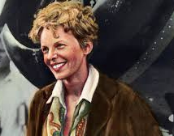
THE MOST DIFFICULT THING IS THE DECISION TO ACT
- Amelia Earhart

Slide 36
THANK YOU
David.marchesseault2@international.gc.ca

Slide 37
Dr. Angelina Mattijo-Bazugba
Assistant Professor of Social Policy and Dean/Director
National Transformational Leadership Institute (NTLI), University of Juba, South Sudan

Slide 38
Role of Government Entities and Strategies for ensuring Gender Responsive M&E
By
Dr. Angelina Bazugba

Slide 39
Role of Government Entities in Strengthening M&E Systems
Political will, Legal and Policy frameworks addressing gendered norms (Fig 1)
Make GE central in policy development, research, advocacy/ dialogue, resource allocation and M&E
Training and capacity building for policy makers
Understand Gender M&E, collect, analyse and verify disaggregated data
Establish Oversight Mechanisms for accountability.
Employ Gender Transformative Approaches- examine, question, change underlying conditions- the norms and power imbalances to attain development objectives

Slide 40
Strategies for Ensuring an M&E System is Gender Responsive
Participatory problem identification/situation to impact tracking
Mainstream Gender Equality Programming in Planning Cycles and Policy Processes
Develop tangible qualitative gender indicators and M&E System
Collect and analyze Gender disaggregated data- education, health
Establish and coordinate Institutional mechanisms –e.g gender focal persons, cluster meetings
Technical backstopping on GM - Human capacity, partnership, M&E, Costed, Advocacy and Organizational Structure

Slide 41
Gender Continuum- from Exploitative to Transformative
Source: Figure adopted from the Interagency Gender Working Group. Available at www.igwg.org/training.
Gender Awareness
Exploitative Accommodating Sensitive Transformative
Gender Equality and Improved development Outcomes
Gender-Blind

Slide 42

Daniella Jacques
Présidente
Chambre de Commerce des Femmes Entrepreneures d’Haiti

Slide 43
SUIVI ET EVALUATIONS POUR LA PRISE DE DECISIONS ECLAIREES AU BENEFICE DE L’EGALITE DES SEXES
PROJET CCFEH-ATTEINDRE/ Financement USAID
PROJET SPOTLIGHT/ Financement UN via ONU Femmes

Slide 44
CCFEH EN BREF

Slide 45
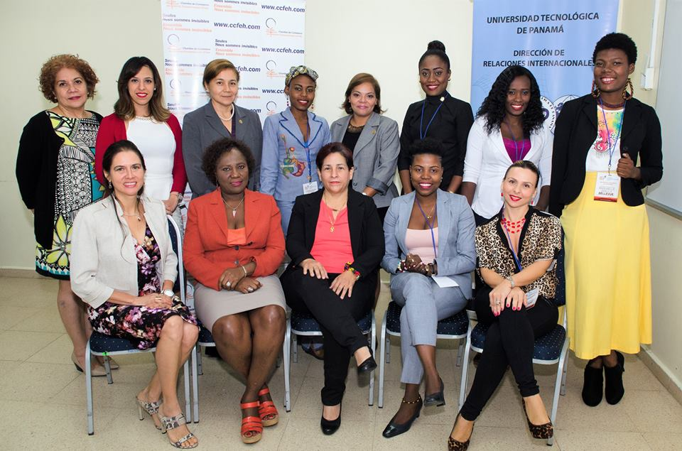

ACTIVITES PHARES
Women Entrepreneuship Week (WEW)
National Women Business Academy

Slide 46

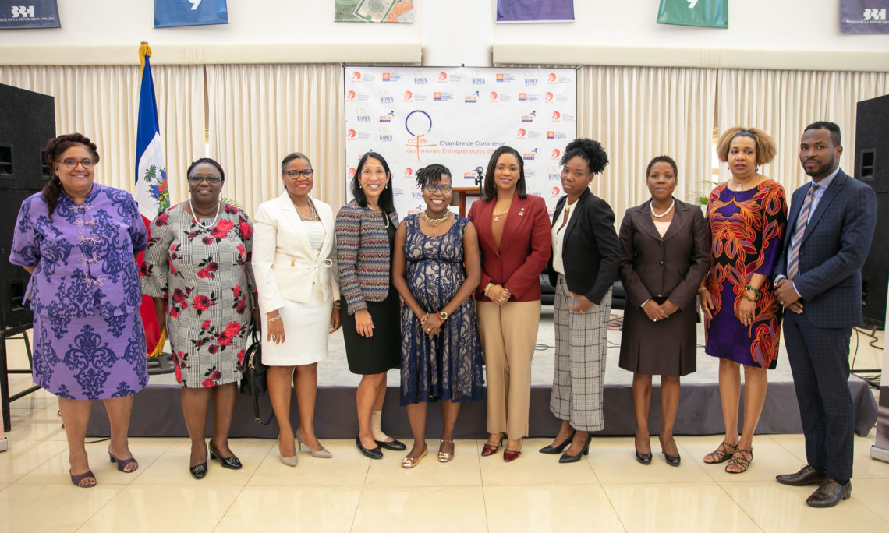
KEY ACTIVITIES
Economic Forum of Women Entrepreneurs of Haiti
International Summit
digital women
Text…
Text…

Slide 47
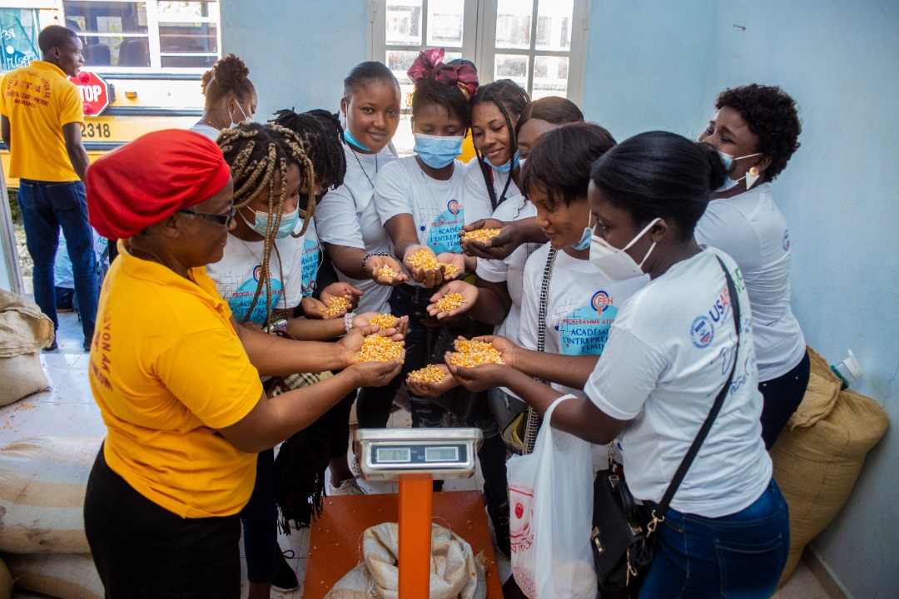
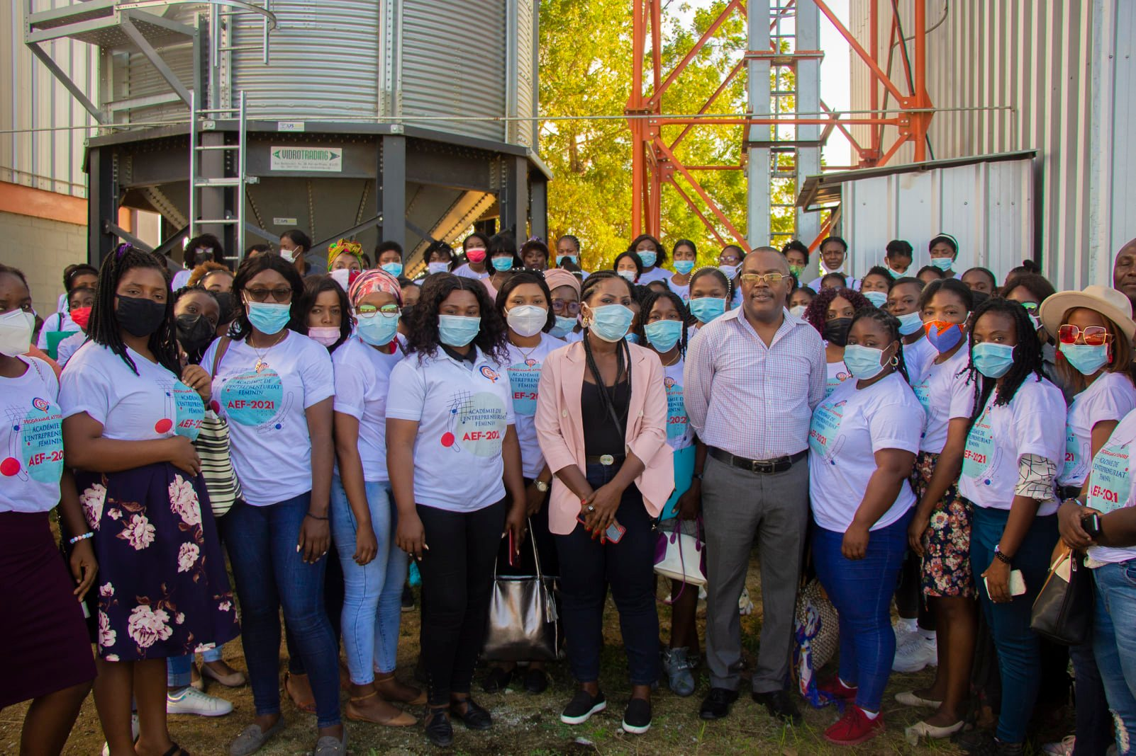
ATTEINDRE/CCFEH PROJECT
Empowering young women entrepreneurs for the creation of wealth and stable and decent jobs
Female Entrepreneurship
Academy (EFA)
Innovative Female
Entrepreneurship Competition
(IFEC)

Slide 48
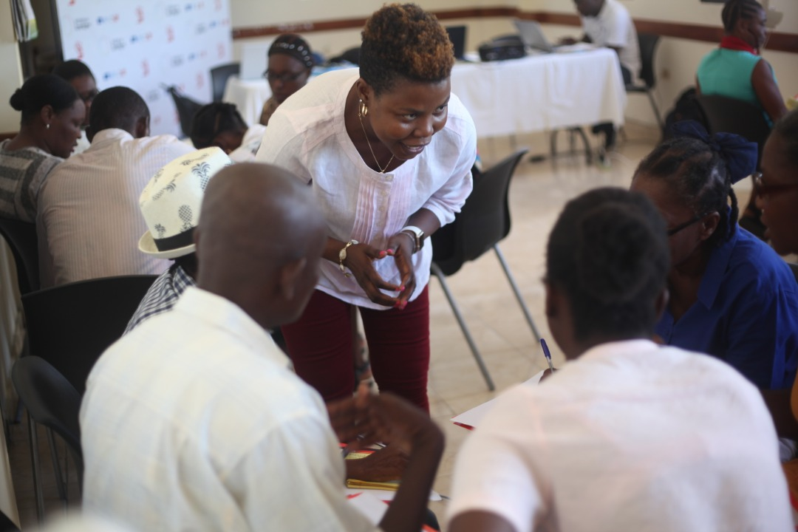
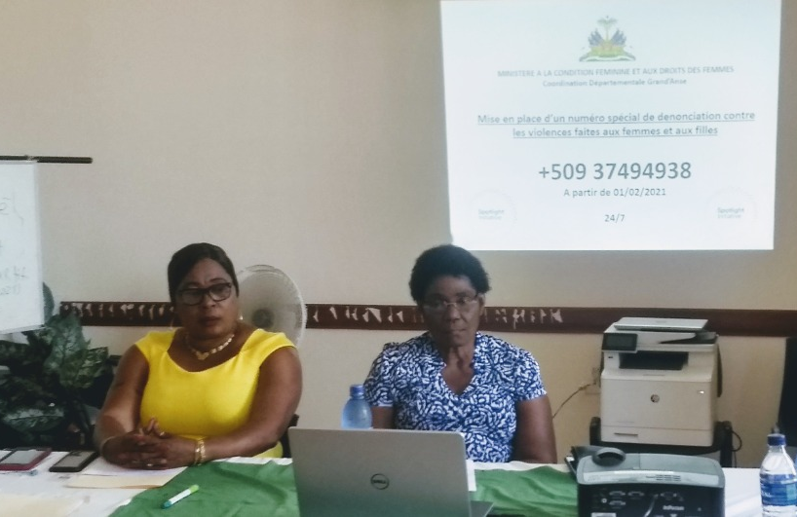
PROJET SPOTLIGHT
Strengthening women's organizations
Advocacy to end violence against women and girls

Slide 49

USE OF SMART TOOLS: SURVEY CTO
- Source of reliable data
- Ensuring the trust of the lessor
- Data storage tool in case of cash from your laptop
- Ease of processing
- Mobility insurance in the data collection process

Slide 50
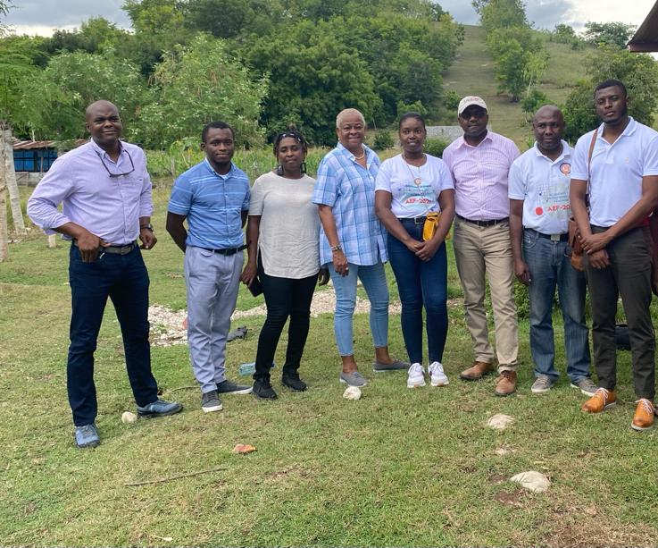
THE PRINCIPLE OF REGULARITY: EVERY QUARTER
Every 3 months is a reasonable and strategic deadline for monitoring small projects, particularly in poor or developing countries.
This delay leaves ample opportunity for radical changes in people's lives and their living conditions especially women and girls.

Slide 51
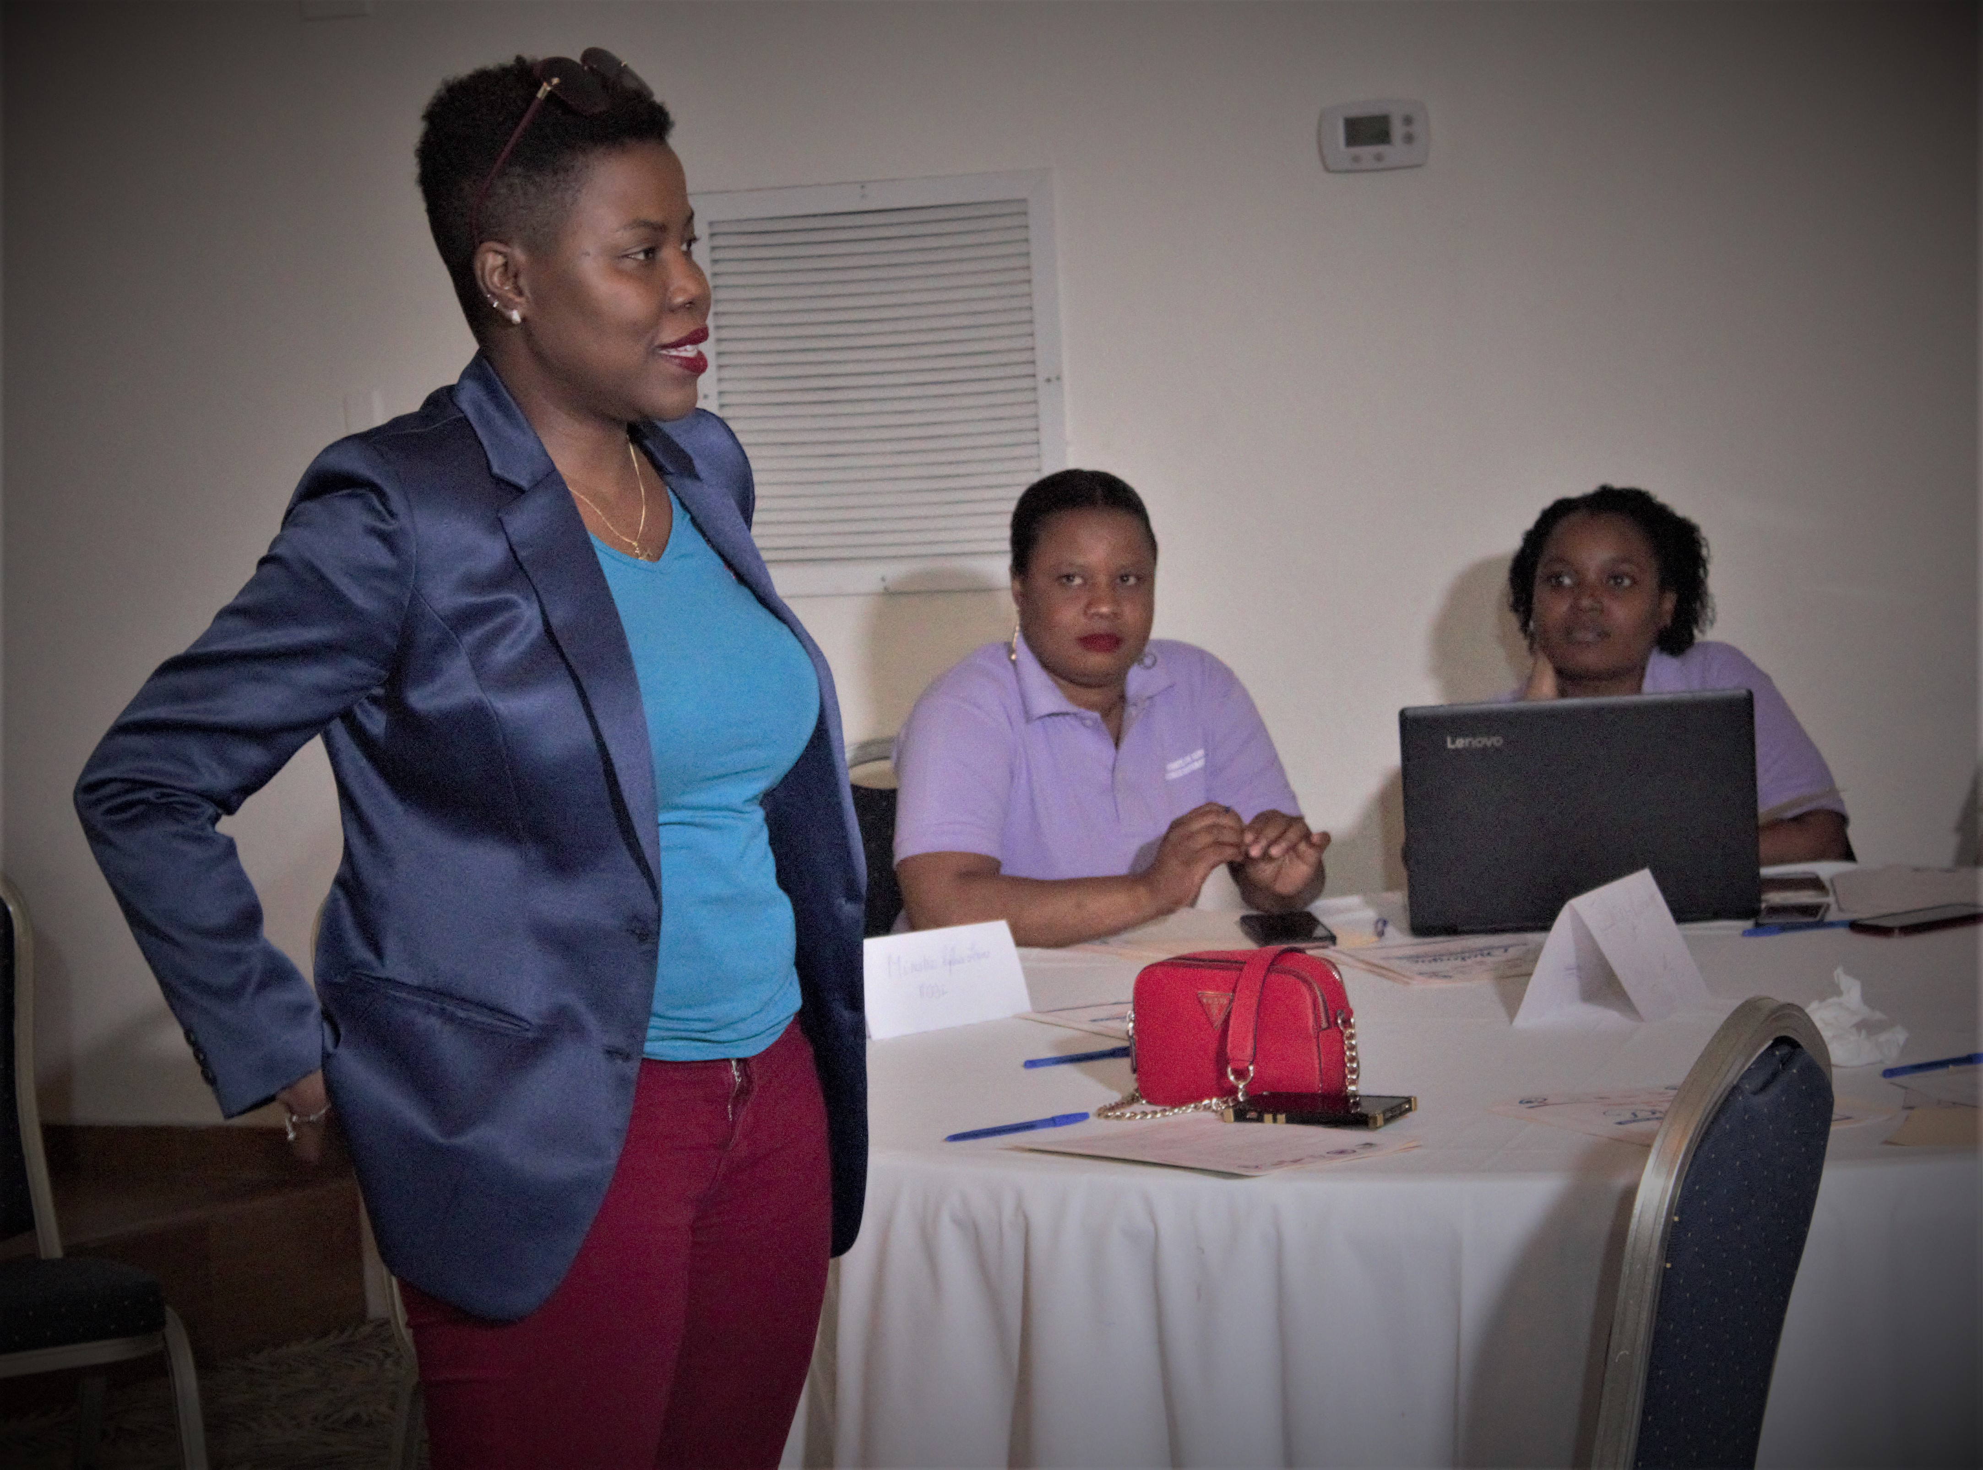
LE SOUCI DES EVIDENCES
Pictures
Attendance list
Mission order
Mission report
Testimonials

Slide 52
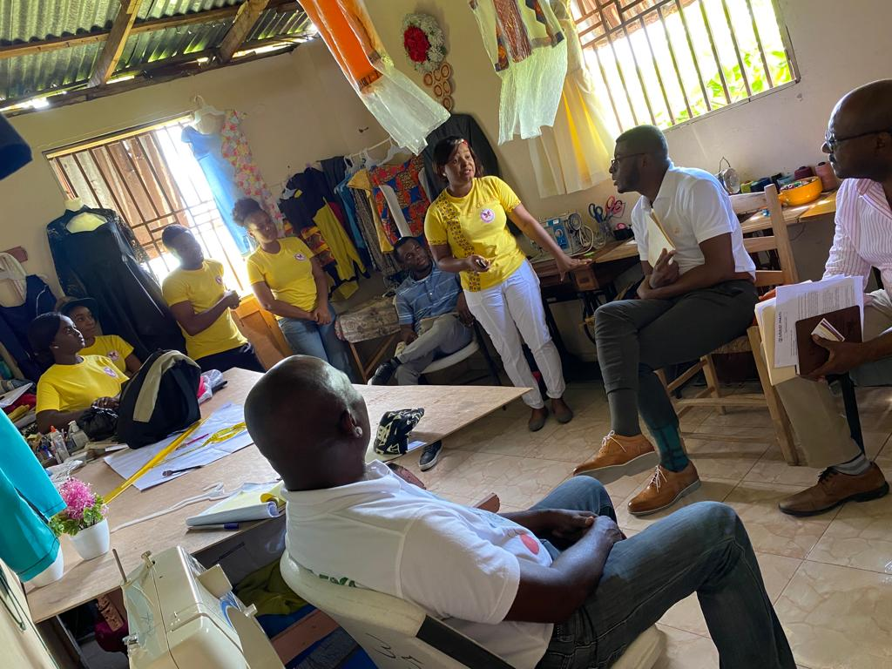
UNDERFUNDING OF MONITORING AND EVALUATION
In the Spotlight and Atteindre projects, we faced a lack of resources for monitoring and evaluation. This made field visits difficult. Thus, certain realities faced by women actors and beneficiaries have escaped us. Hence the need, from the project design phase, to take into account the various aspects of monitoring and evaluation in budget planning.

Slide 53
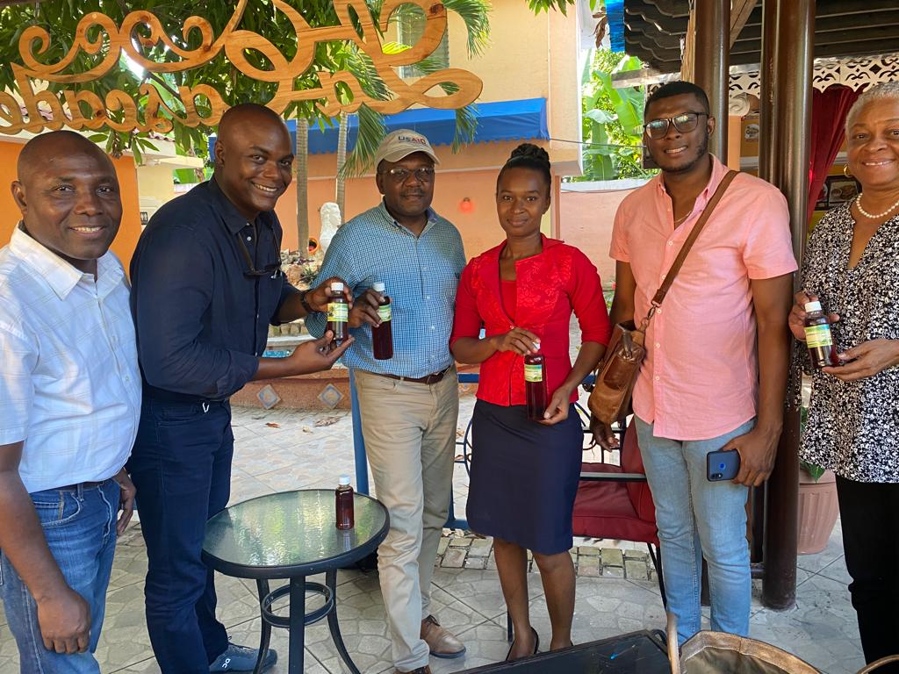
MONITORING AND EVALUATION AS A STARTING POINT
As part of the implementation of our projects, we made the wrong calculation to recruit the focal point for monitoring and evaluation after 3 months from the start of the project.
Capital error!
Monitoring and evaluation should be starting points for the project.

Slide 54
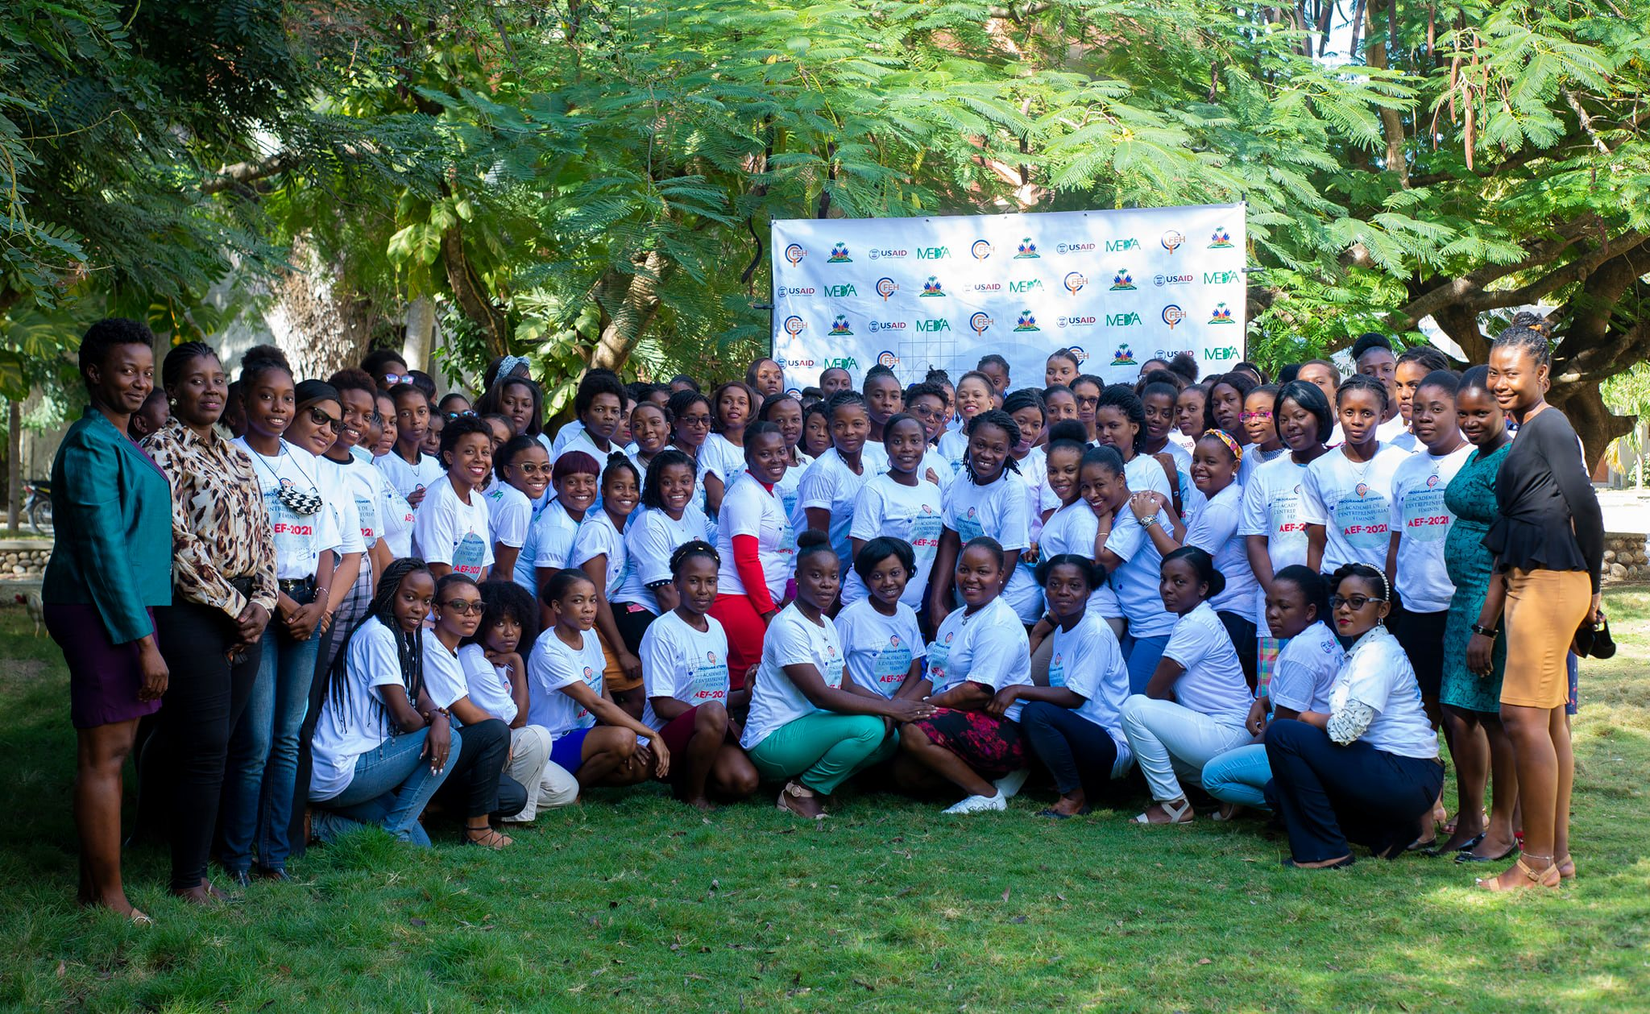
MONITORING, EVALUATION AND COMMUNICATION: THREE ATTACKERS
These two experiences made it clear that monitoring, evaluation and communication must work together. This trio can contribute to the mobilization of resources by highlighting the achievements and the positive impacts in the lives of the beneficiaries of the initiatives

Slide 55

THANK YOU

